Slide 1
Webinar
Human Centred Remote Maintenance
& Asset Management
Speakers:
Joshua Barbian – SCHMIDT+HAENSCH
Mathias Horner - Maintastic

Slide 2
Agenda
01
02
03
04
05
Company context
Motivation & XR 5.0 Project Goals
Our Approach:
AI Assistant & XR
Adoption guardrails
& Advice
Survey
Introduction to SCHMIDT + HAENSCH and Maintastic
Why asset teams need faster access to knowledge.
From natural-language reporting to guided troubleshooting.
AI-enabled use cases
How to keep it human-centred, safe, and useful.
Your perspective on AI, XR, and the future of maintenance

Slide 3
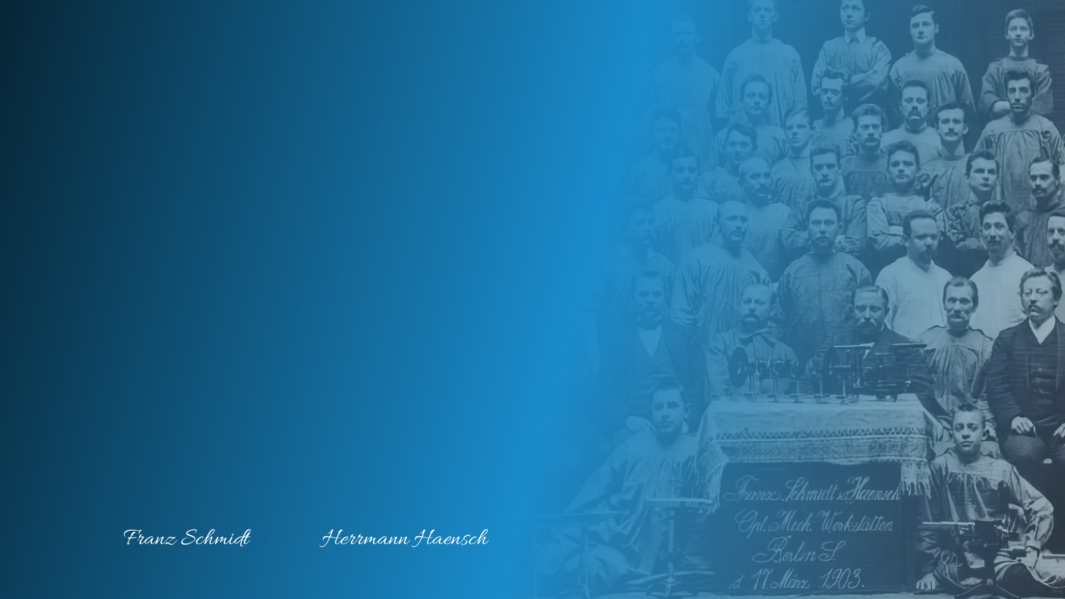

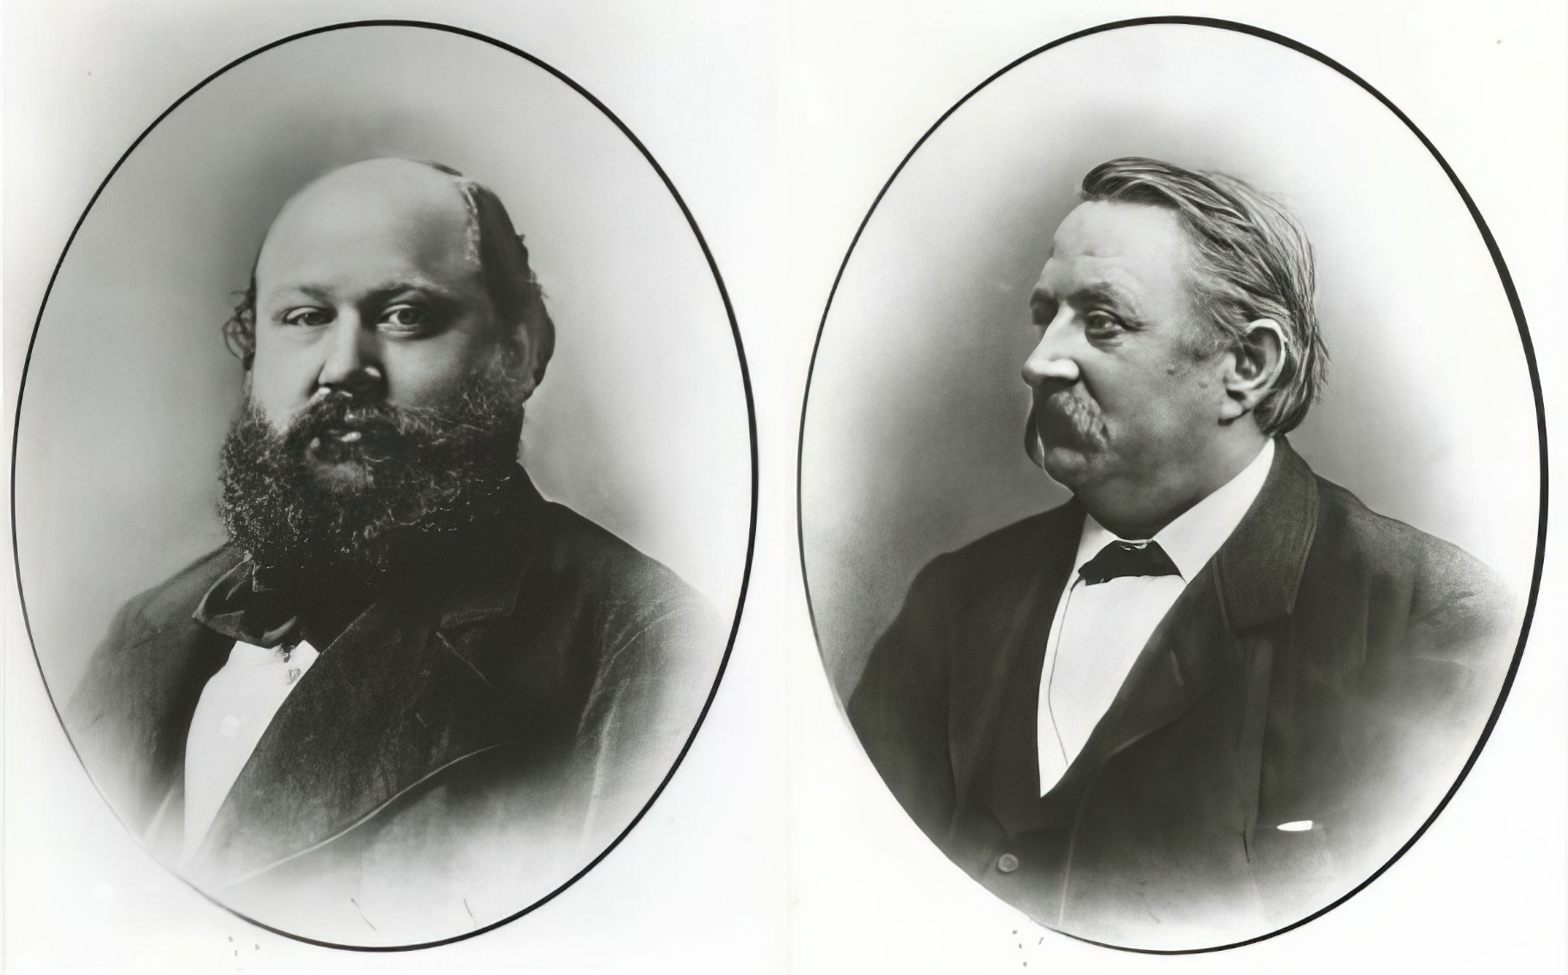
Our
Company Founders
EXCELLENCE IN PRECISION MEASUREMENT
SCHMIDT + HAENSCH has developed from a rich history of engineering and scientific research. The family-run company was founded by Franz Schmidt and Herrmann Haensch in 1864 and has been part of innovative German technology from the beginning.
Notes:
3+4 entfernen, Abbe Refractometer auf 3, 5 auf 4 verschieben, 5 iCS Roboter
5 farblich anpassen

Slide 4

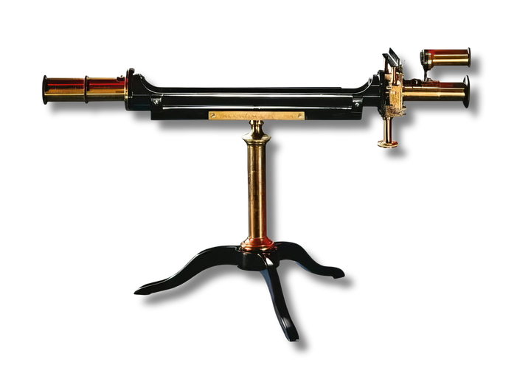
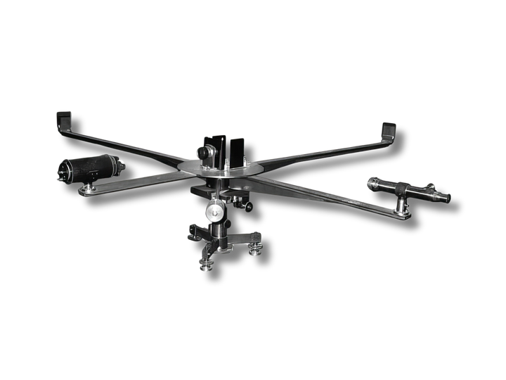
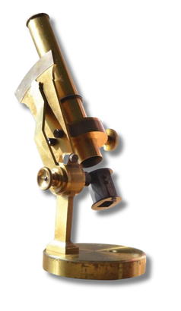
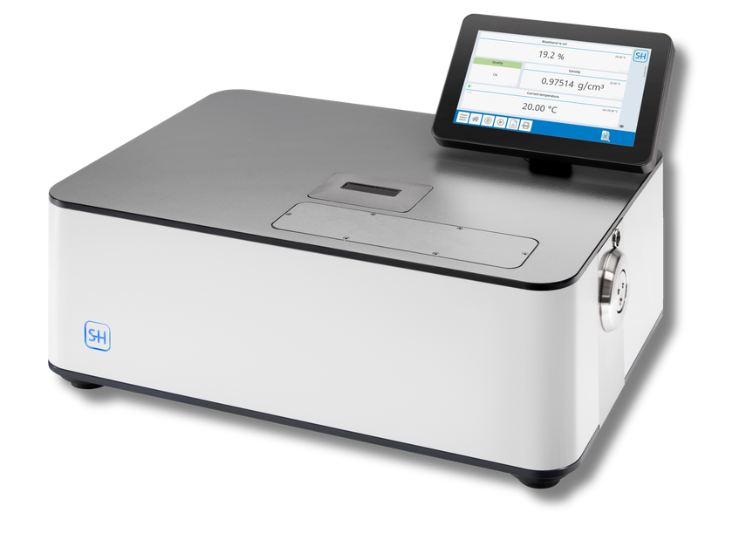
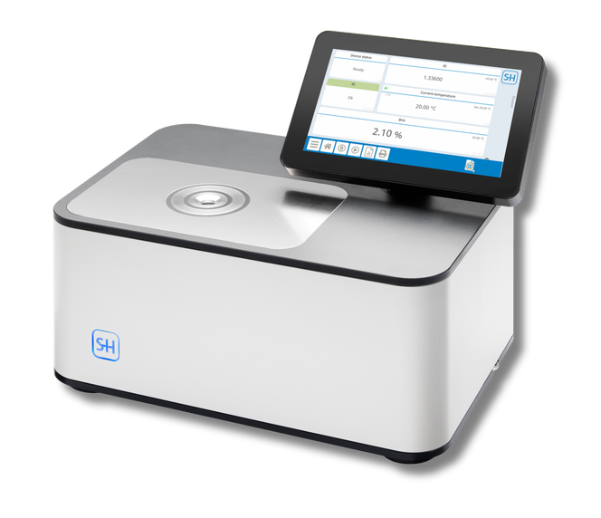
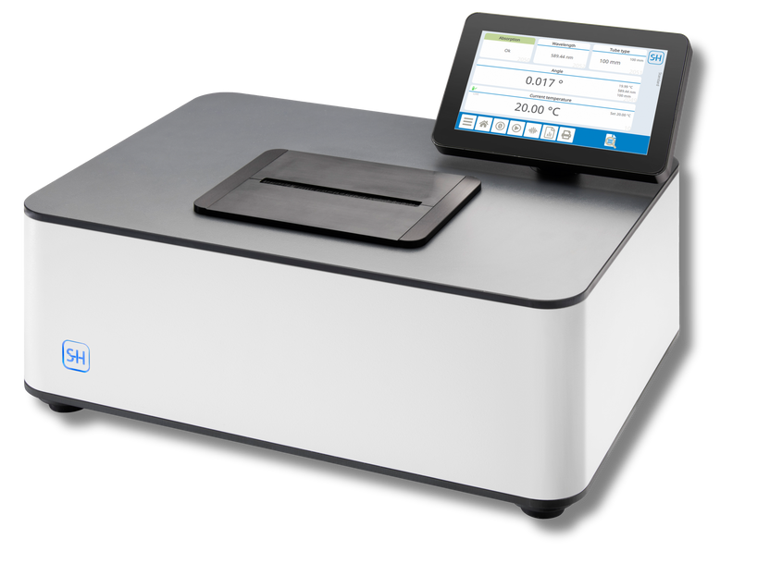
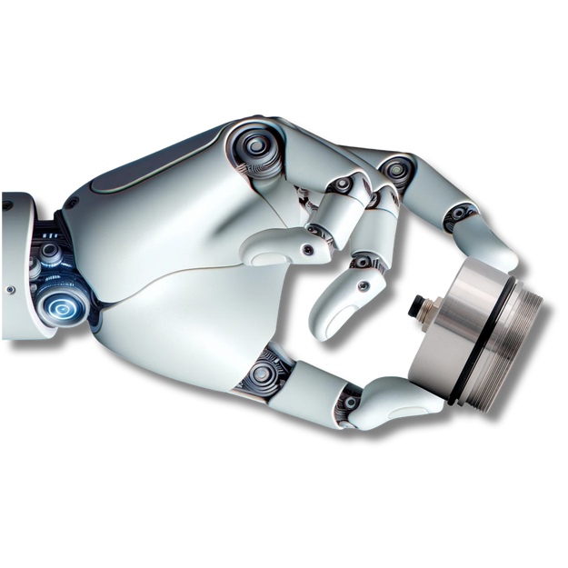
Our History
EXCELLENCE IN PRECISION MEASUREMENT
S+H founded by Franz Schmidt and
Herrmann Haensch in Berlin
1864
1864
Developing quartz wedge polarimeter in cooperation with Karl Ventzke
Manufacturing microscopes for Rudolph Virchow
1879
1881
Manufacturing interferometer for Michelson-Morley experiment
Manufacturing of Abbe refractometer with Pulfrich-principle
1895
1905
Manufacturing circle polarimeter for Swiss Nobel Price winner Alfred Werner
Manufacturing color mixing apparatus according to Helmholtz-König
1921
1963
Developing and manufacturing of worlds first fully automatic sugar polarimeter with digital display and printer
First fully-automatic table refractometer with measuring range up to 1.72000 and a resolution of 10⁻⁵ Brix
1986
1992
Developing first refractometers for process
control
Introduction of patented
Multi-Wavelength Refractometer
2005
2018
Launch of the VariFamily -
Refractometer, Polarimeter and Density Meter
Development of the SpectroPol -
multi-wavelength scanning polarimeter
2022
2023
Introduction of the iCS -
the world’s smallest process refractometer
SCHMIDT + HAENSCH celebrates
160 year anniversary
2024
Notes:
3+4 entfernen, Abbe Refractometer auf 3, 5 auf 4 verschieben, 5 iCS Roboter
5 farblich anpassen

Slide 5


FROM LOCAL ROOTS TO GLOBAL IMPACT

Slide 6

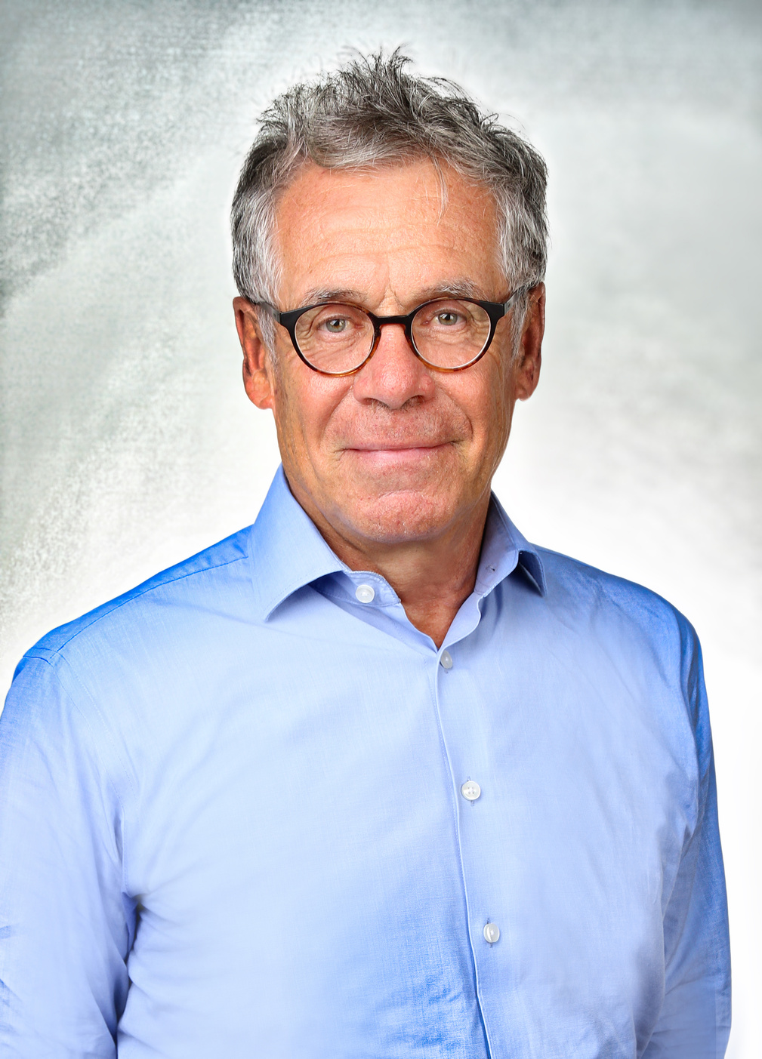
From Local Roots to Global Impact
>100.000
>100
Costumers
Countries
1
>17.000
>80
Family
Citations
>1.000
Distributors
1
Material
Parameters
>60
Dedicated Team
Mathis Kuchejda
Company Owner & Managing Director
>250
Service Locations
1
Applications
27
HQ in Berlin
Proudly family-owned for five generations, with the sixth generation preparing to continue the legacy.
8
Industries
Services
Notes:
1. Values, 2. Presence, 3. Reference
Costumers first 100.000
Bildeinfärbung überdenken
Rechtsbündig und links Management+Emotional Text
Folie überdenken und an Slide 3 Joshua anpassen?

Slide 7

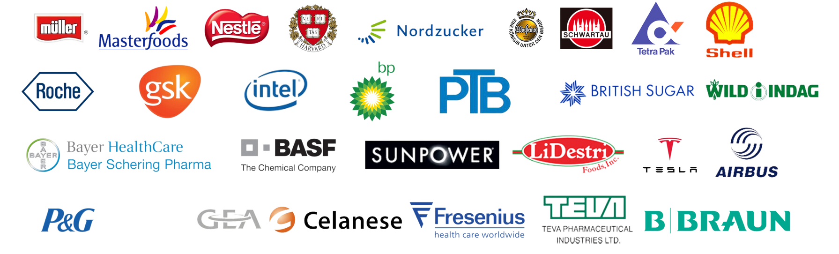

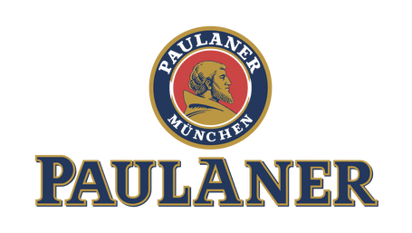







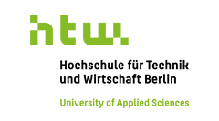




References
EXCELLENCE IN PRECISION MEASUREMENT
Client References
Official Research Partners and Associations

Slide 8
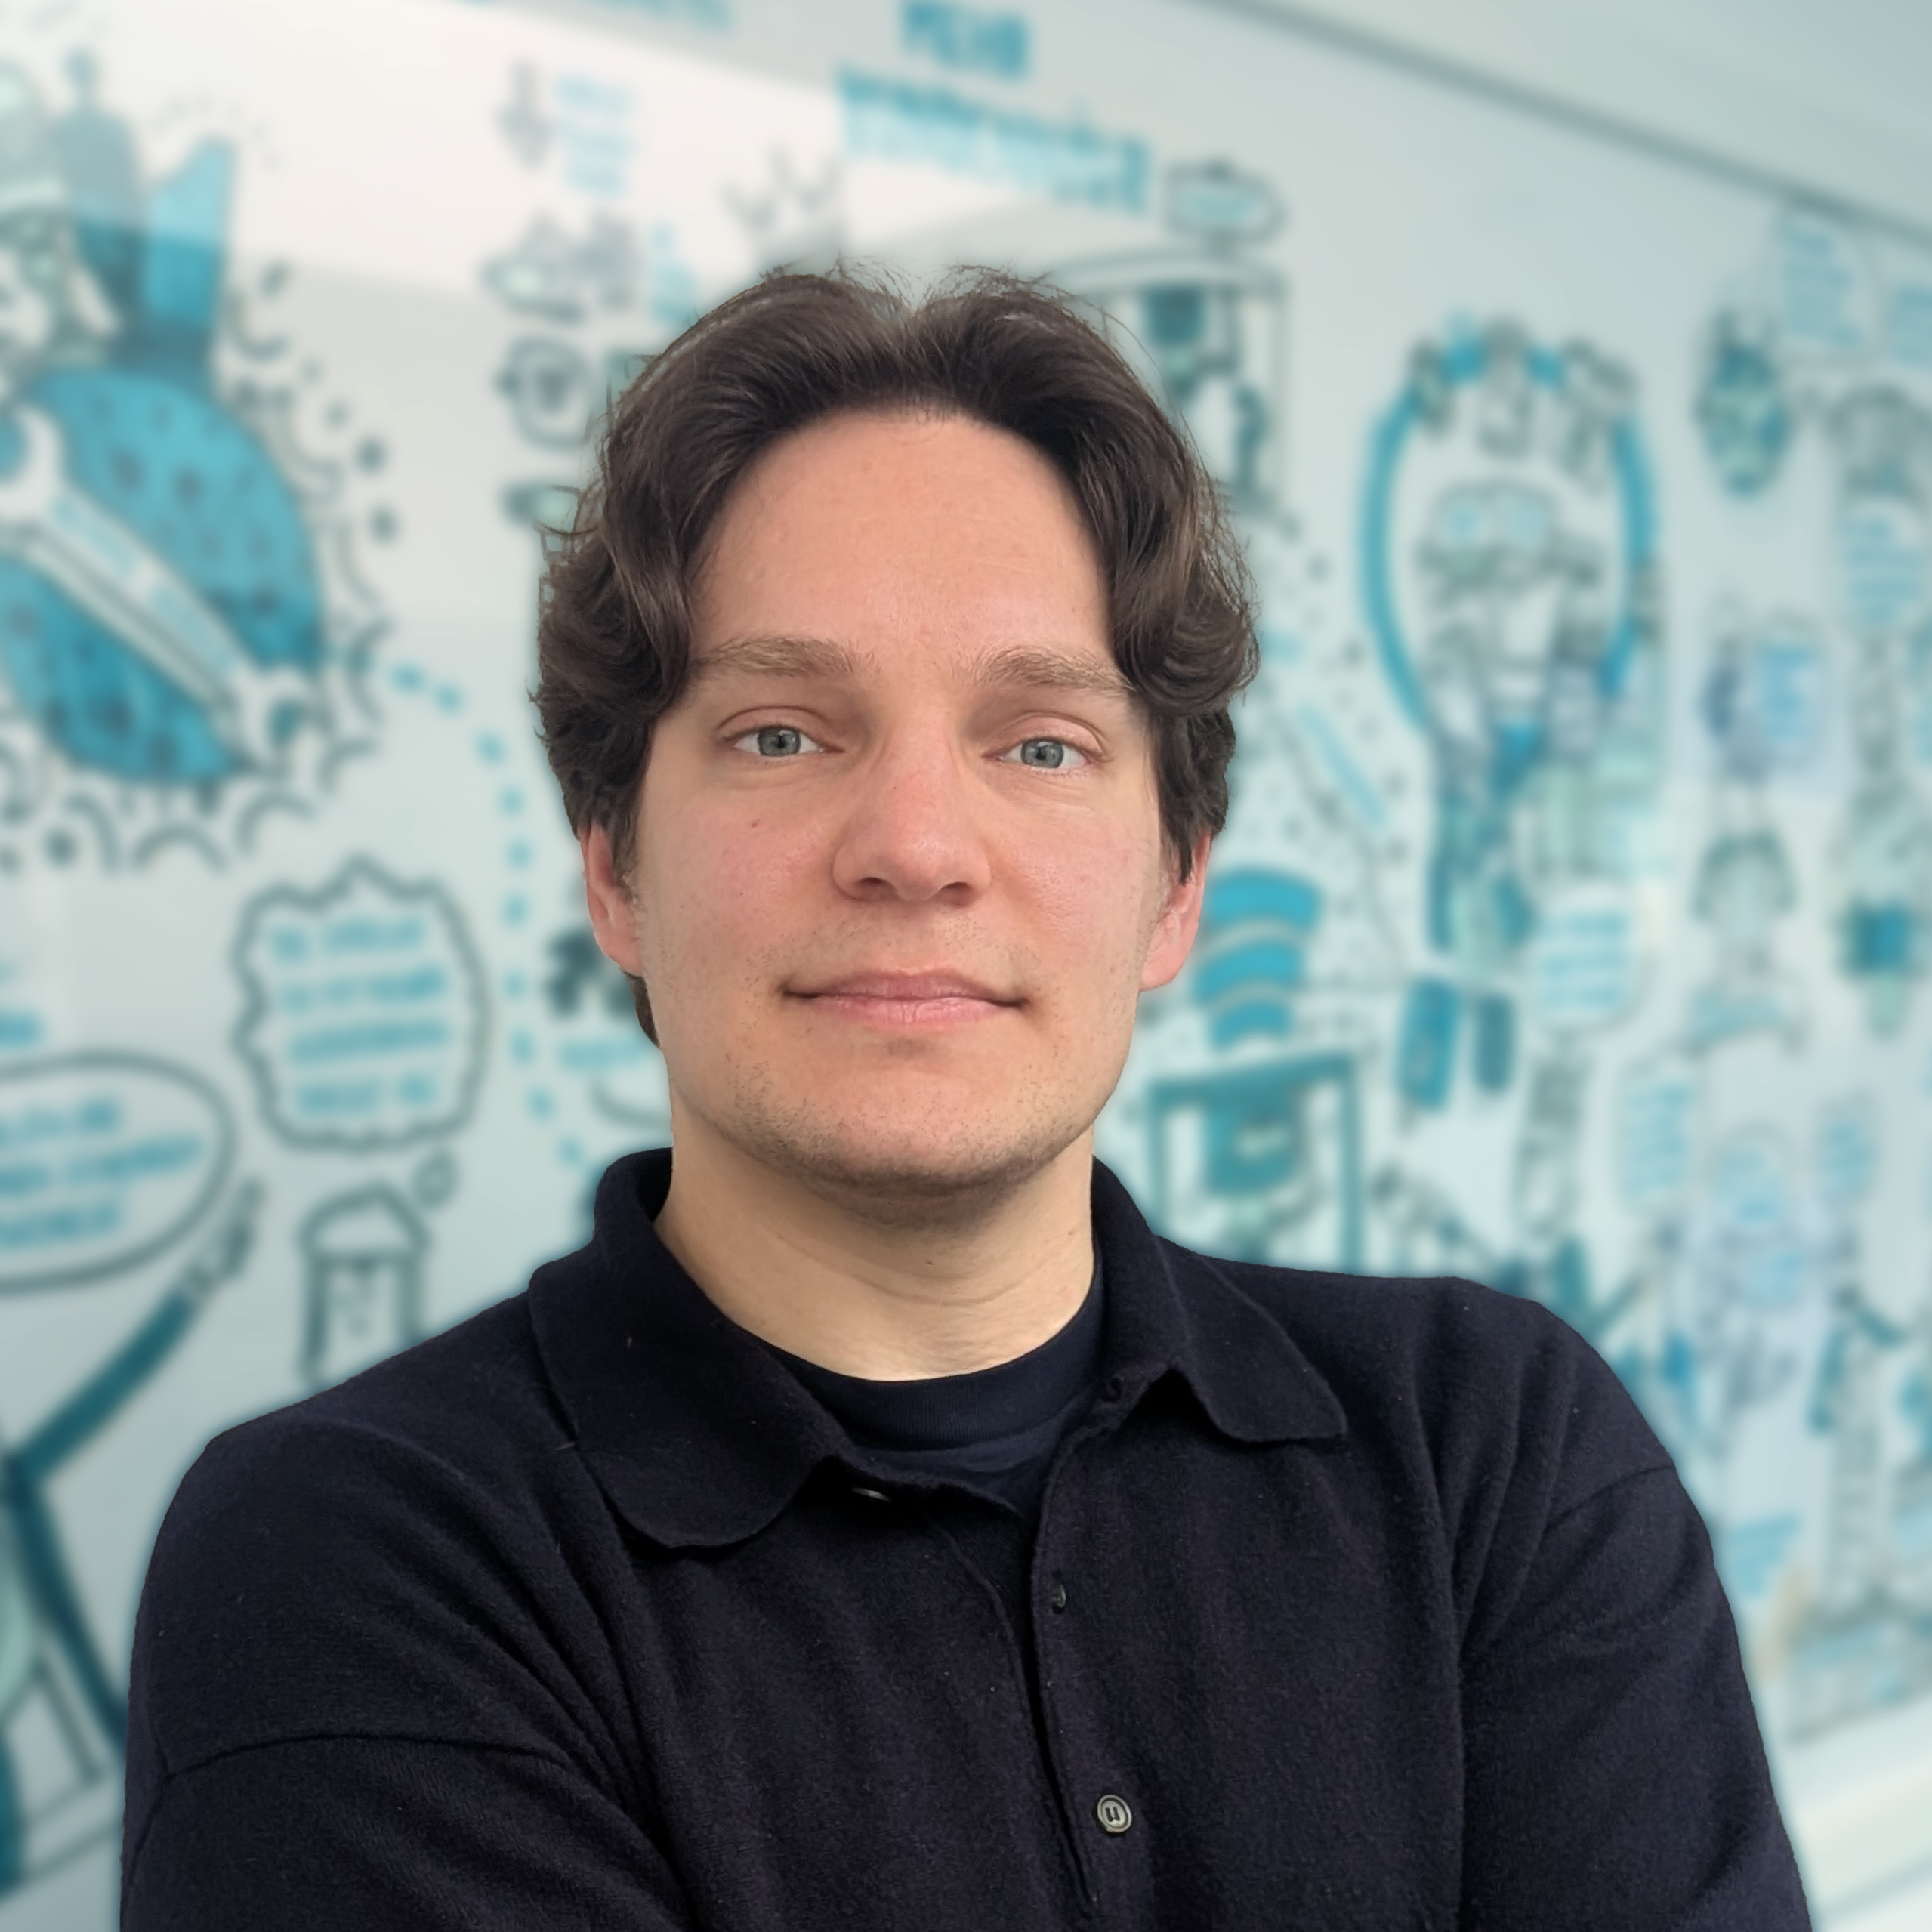
Maintenance management software
Made for technicians.
Mathias Horner
Product Manager

Slide 9
Background
We have been transforming industrial processes since 2016
2016
2025
120+
founded as oculavis
re-branded to Maintastic
Customer
27001
60+
4.8 M
ISO/IEC certified
committed Employees
Revenue

Slide 10
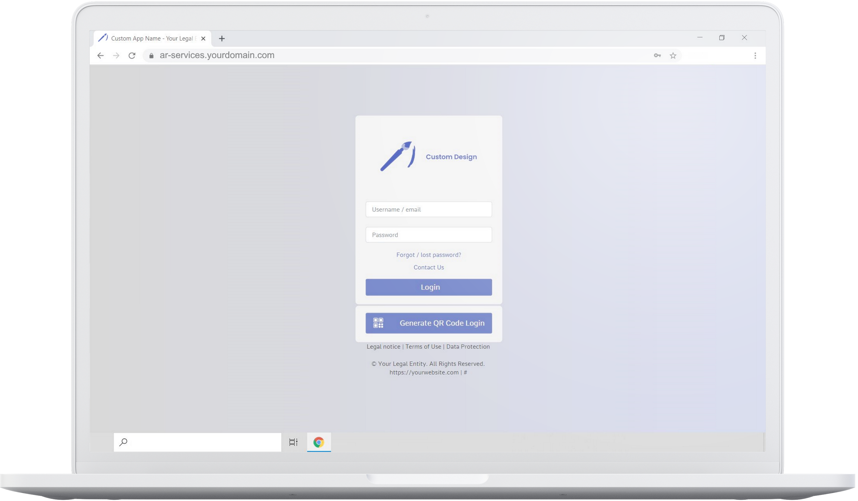
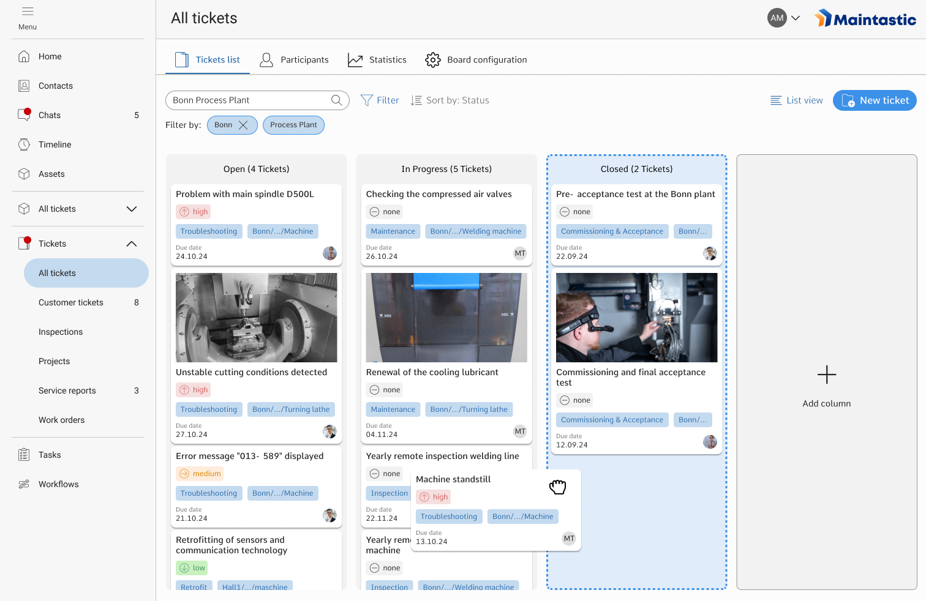
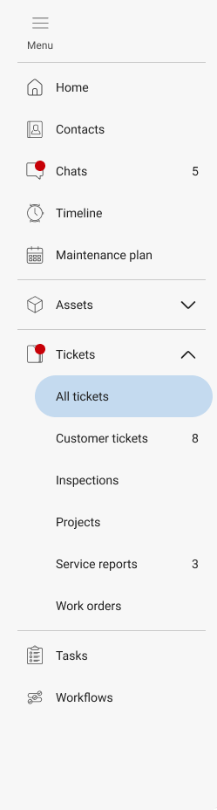
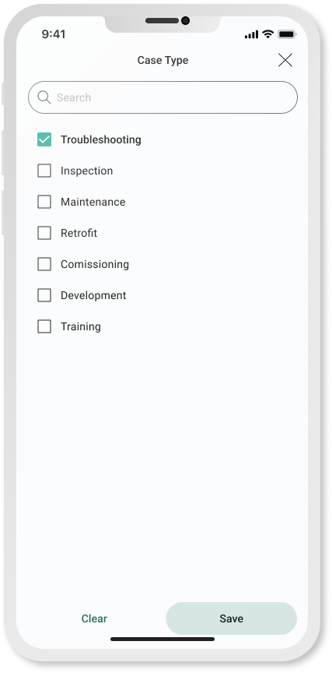
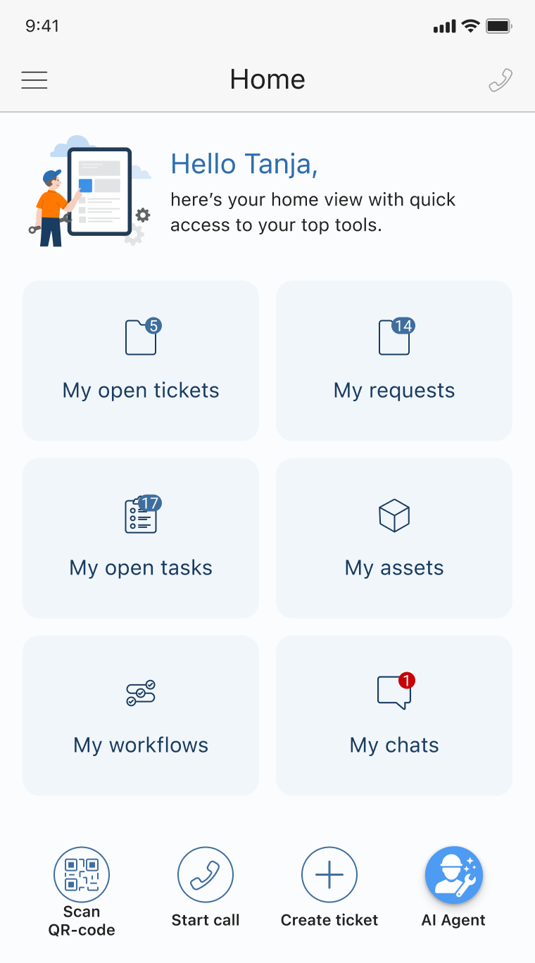
Our Solution
The AI-powered & collaborative CMMS
Ticketing & Work Order Management
Checklists & Instructions for SOPs
Asset Management & Spare Parts
Interfaces and integrations
Collaboration with AR Video and Chats
AI Agents

Slide 11
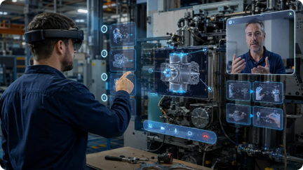
Motivation
AI + XR change how maintenance knowledge reaches the shopfloor
Downtime, knowledge gaps, and technical complexity meet directly at the asset.
Exactly where teams need fast, trusted guidance.
Technology drivers
End-user problems
XR-enabled maintenance scenarios
AR / VR glasses
+ AI assistant
Less time.
Less expert access.
More system complexity.
• Immersive retrofitting & training
• XR video call between remote expert and service technician
• AI-powered knowledge retrieval and voice-commands
• Guided workflows in the XR environment
Microsoft HoloLens 2 as a practical XR interface for immersive retrofitting, training, and remote collaboration.
Technicians need contextual support without leaving the machine or waiting for the right expert to be on site.

Slide 12
Pilot #2
Human Centered Remote Maintenance & Asset Management
Use Cases
UC 2.1 – Expert Maintenance as a Service
„[…] Virtual assistance software to enable remote inspection and maintenance of laboratory instruments through an XR environment.“ - DoA
UC 2.2 – Immersive Retrofitting
„[…] Provide remote guidance to site technicians for performing retrofitting tasks.“ – DoA
Objectives
„[…] use the service technicians' expert knowledge efficiently and reduce the amount of on-site service work.“ – DoA
KPI‘s
  Reduce of on-site maintenances >= 50%
  Time to complete the tasks <= 25% increase
  5-scale rating of site technicians’ satisfaction

Slide 13



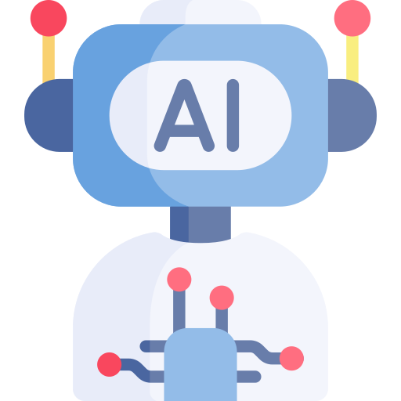
Pilot #2
Personas
Priority I
Priority II
Priority III
Assistance Provider
Assistance
Provider & Recipient
Assistance Recipients
AI Co-Pilot
Has access to all service documentation
Provides assistance 24/7
Communicates to all kind of devices
Service Technician Expert
> 5 years of service experience
Located in Headquarter or Service Hub
Works on desk with desktop computer
Field Service Technician
S+H Service Employee or S+H Partner
Works in the field (on site of asset)
Works with mobile devices
(e.g. laptop, tablet, smartphone, smartglasses)
Equipment Operator
Employee of customer
Works in the laboratory (on site of asset)
Works with mobile and desktop devices
(e.g. laptop, PC, tablet, smartphone)

Slide 14
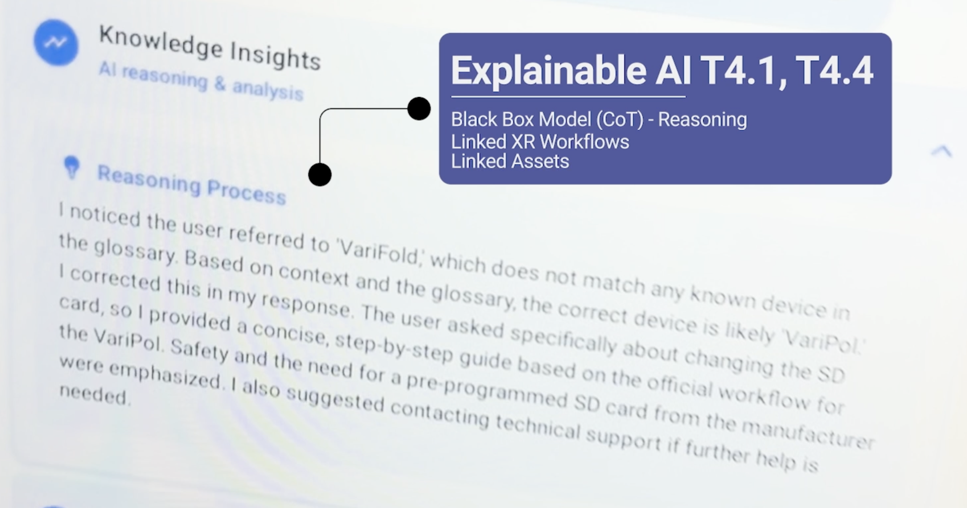
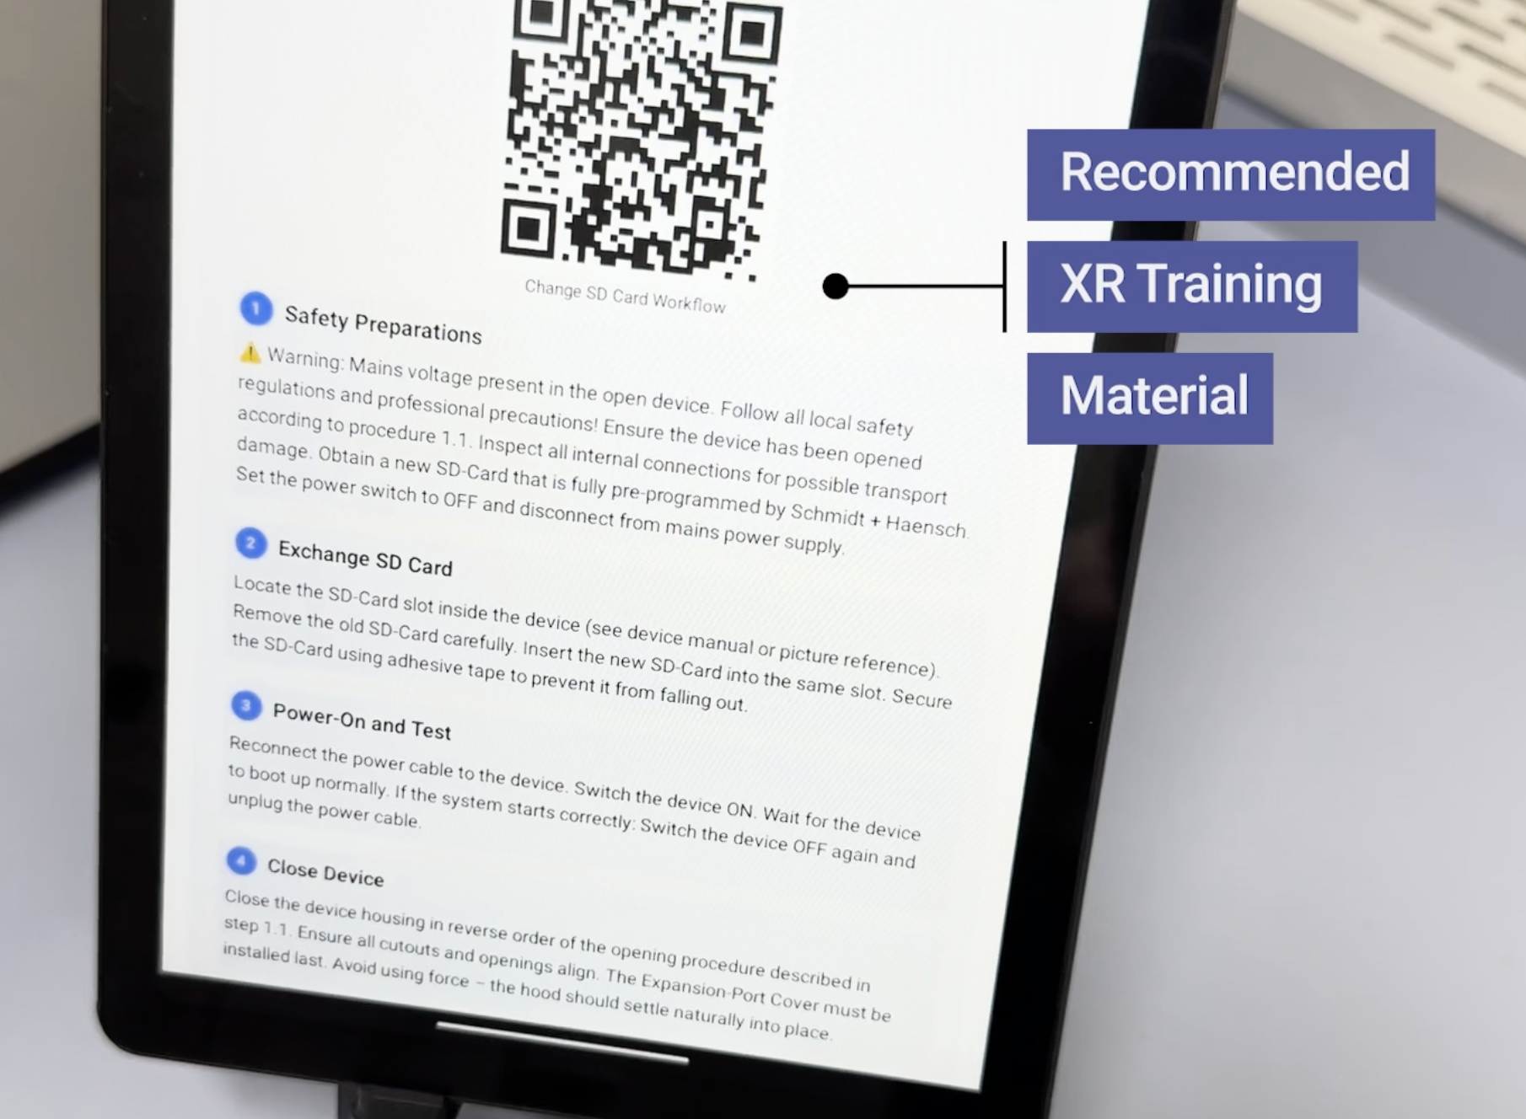
AI Assistant
ChatBot Interface

Slide 15
Technology drivers behind the AI Assistant
1
2
3
4
LLM
Understands technician intent, summarizes context,, and generates concise next-step explanations.
RAG
Retrieves grounded information, and known fixes before the assistant answers.
Speech-to-Text
Converts voice into text so technicians can work hands-free at the asset.
Text-to-Speech
Speaks the response back while the same answer is printed on the interface for traceability.
Technician speaks
STT transcript
LLM + RAG
Answer + actions
Voice + text UI
This creates accessibility, documentation, and auditability while keeping the technician in control.

Slide 16
Explainability increases trust
Black-box models
For maintenance, a fluent answer is not enough. The assistant must show why it recommends something.
Black-box risk
LLMs may sound confident while missing context, using outdated sources, or hallucinating a procedure.
Explainable output
Use source-grounded explanations:
cite the manual, ticket, checklist, or asset history behind the answer.
Human approval
Show uncertainty, and keep technician or expert approval explicit before operational changes.
Trust paradigm
Do not ask technicians to trust the AI because it sounds confident.
Let them trust the system because it shows sources, assumptions, limits, and approval points.

Slide 17
Demo
17

Slide 18
High-value AI-Assistant use cases in maintenance
Where conversational AI creates practical value first
1
Voice-to-ticket
4
Troubleshooting guide
1
2
Capture faults hands-free
Ask follow-up questions, retrieve manuals, and suggest next checks.
2
Knowledge assistant
5
Remote expert handoff
3
4
Summarize previous tickets and known
Prepare a clean case package before escalating to a specialist.
3
6
5
Workflow generation
6
After-action documentation
Draft task lists or inspection steps from validated documentation.
Turn technician notes into clean history entries and learnings.

Slide 19
Reference architecture
Keep AI grounded in trusted maintenance data
Technician interface
AI orchestration
CMMS backbone
Human control
Mobile app
Voice input
QR/NFC asset entry
Intent detection
RAG over knowledge base
xAI & CoT Safety Measures
Assets
Tickets & work orders
History & checklists
Approvals
Expert escalation
Audit trail
→
→
→

Slide 20
Takeaways for implementation
Start focused, measure outcomes, scale responsibly
1
Start with one painful workflow
Example: fault reporting, information search, or recurring troubleshooting.
Modern maintenance is not “AI instead of people”.
It is people, assets, and knowledge connected through smarter interfaces.
2
Connect to real context
Assets, documents, previous tickets, spare parts, checklists, and permissions.
3
Measure operational impact
MTTR, first-time-fix rate, search time, documentation quality, user satisfaction, reduced travel time.
4
Keep humans accountable
Use AI for suggestions and documentation support; keep approvals and safety-critical decisions explicit.

Slide 21

Survey
Mentimeter
Your perspective on AI, XR, and the future of maintenance

Slide 22
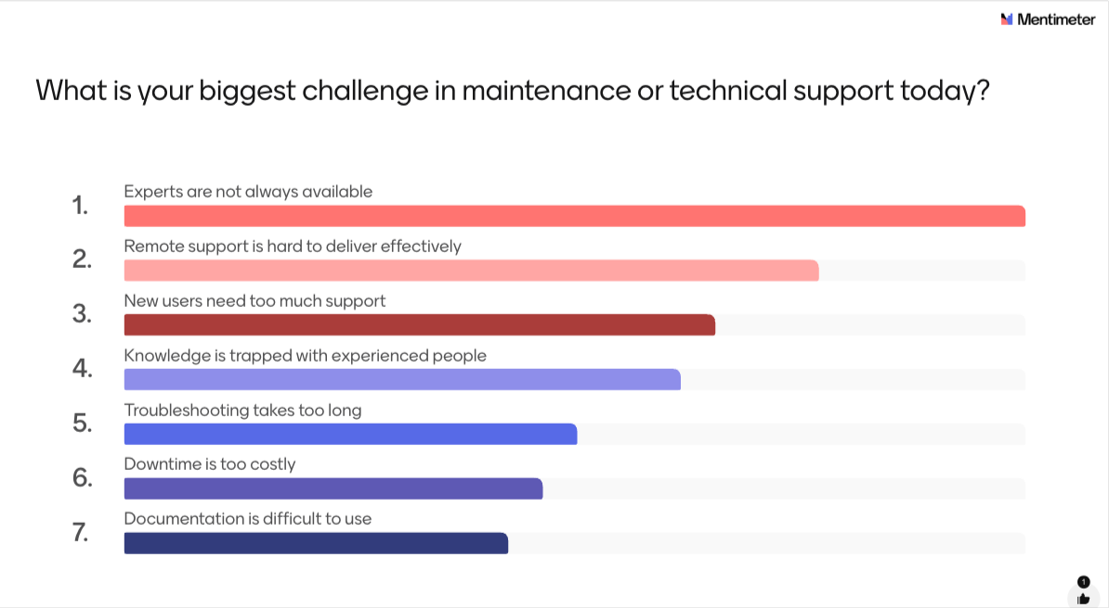
Survey
Mentimeter

Slide 23
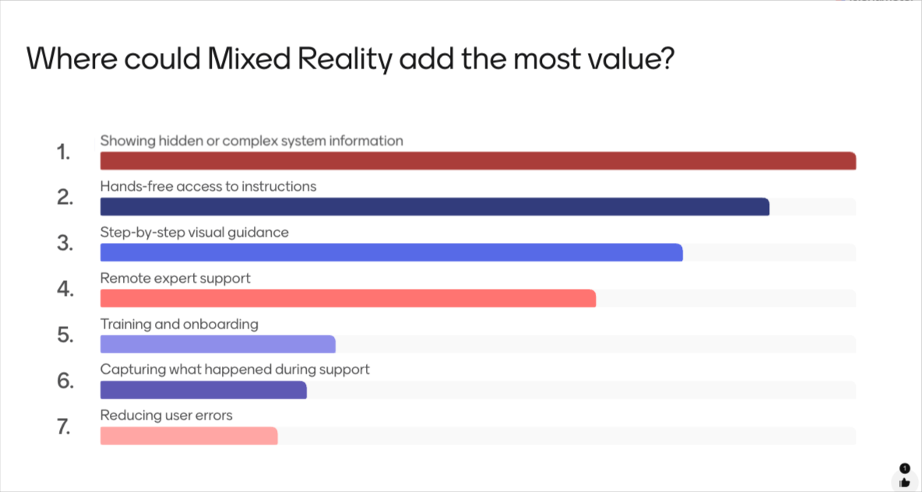
Survey
Mentimeter

Slide 24
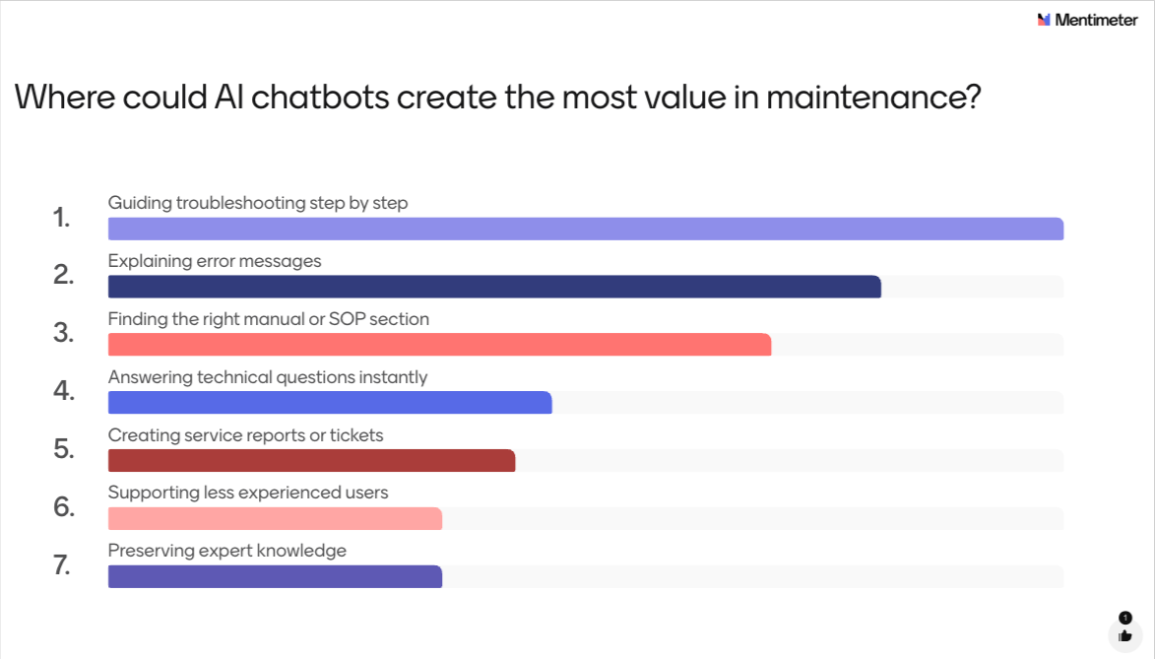
Survey
Mentimeter

Slide 25
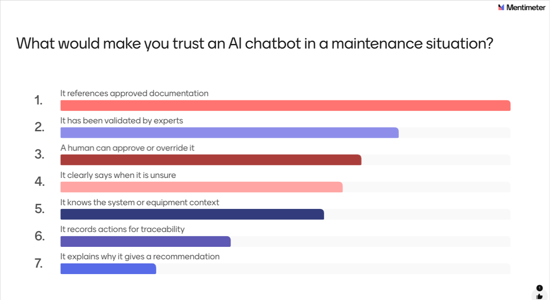
Survey
Mentimeter

Slide 26
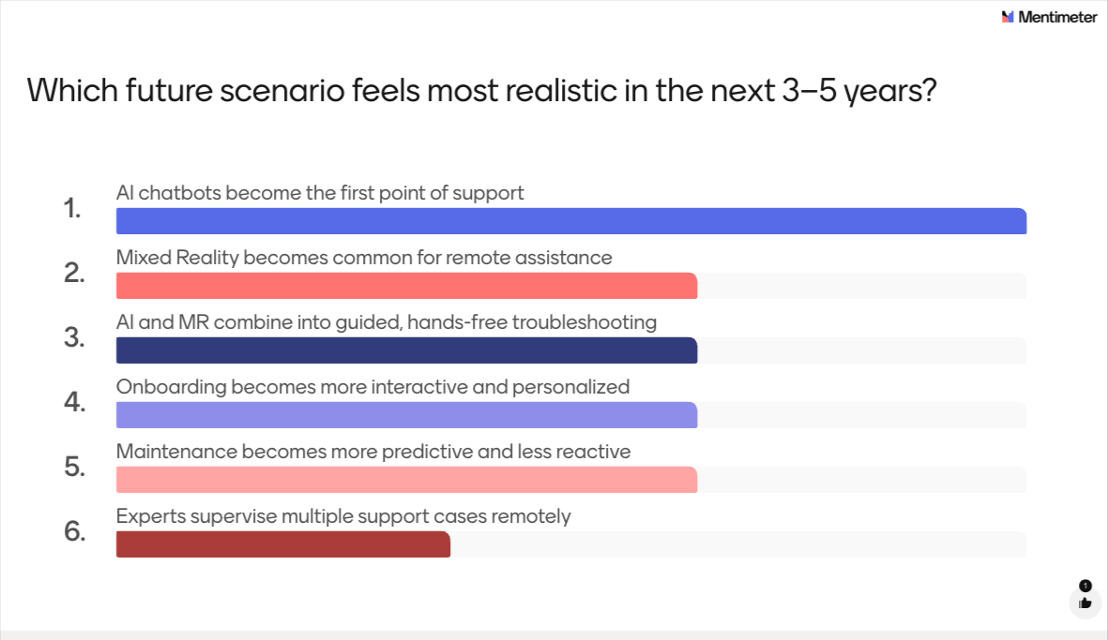
Survey
Mentimeter

Slide 27
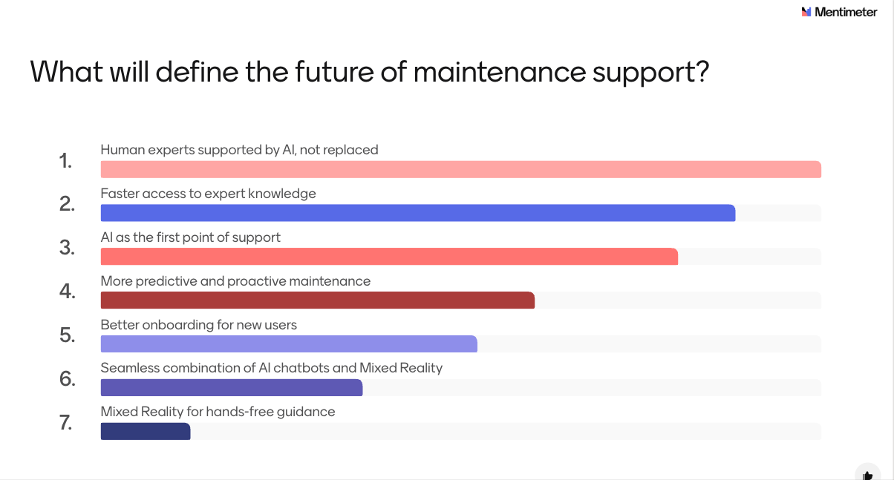
Survey
Mentimeter

