Slide 1
Pilot 5 Webinar
Enhancing Technician Training & Remote Support with XR & AI
Speakers:
Emmanouil Mavrogiorgis (SYN),
Dr. Nikolaos Papadakis (SPACE HELLAS)

Slide 2

Introduction to the Webinar
Overview of XR5.0 project
Focus on Pilot 5 demonstration
XR & AI technologies for Industry 5.0
Agenda overview

Slide 3



Pilot 5 at a Glance
What is Pilot 5 about?
• XR training for edge device assembly
• AI-powered support for repair tasks
• Personalized guidance for technicians
• Improved safety, efficiency & performance

Slide 4
Training Challenges

Slide 5
Training Challenges
Industrial Training Limitations
• Complex assembly procedures
• Different technician skill levels
• High training time & cost
Use Case #5.1 | User Story (Requirement) Description | Expected KPIs | Achieved KPIs
 | Create personalized training workflows using AI to enhance efficiency and engagement | Assembly Time Reduction>20% Repair Time Reduction>20% Increased Engagement>50% Cost Reduction>20% | N/A
 | Need for accessible, cloud-based training materials to support ongoing learning and quick access. | Assembly Time Reduction>20% Repair Time Reduction>20% Cost Reduction>20% | N/A
 | Technicians need instructions to quickly perform device commissioning | Assembly Time Reduction>20% Repair Time Reduction>20% Cost Reduction>20% | N/A

Slide 6
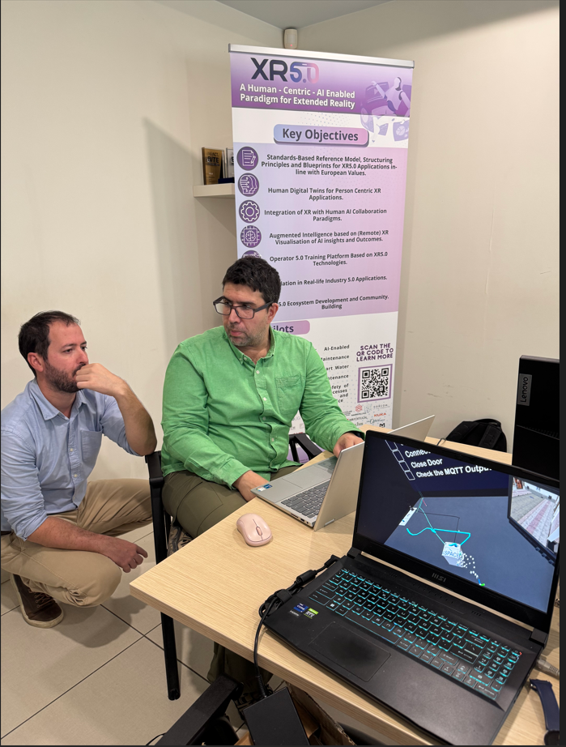
XR Training Approach
Immersive & Personalized Learning
• VR-based training scenarios
• Interactive 3D device visualization
• Realistic simulated environment
• Hands-on learning without risk

Slide 7
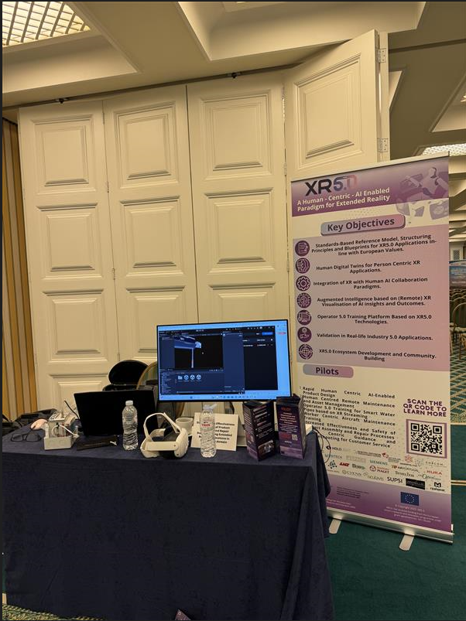
AI Personalization
Adaptive Training Workflows
• Skill-level based scenarios
• Beginner → Step-by-step guidance
• Intermediate → Condensed workflows
• Real-time feedback & performance tracking

Slide 8
AI Personalization
Adaptive Training Workflows
• Skill-level based scenarios
• Beginner → Step-by-step guidance
• Intermediate → Condensed workflows
• Real-time feedback & performance tracking

Slide 9


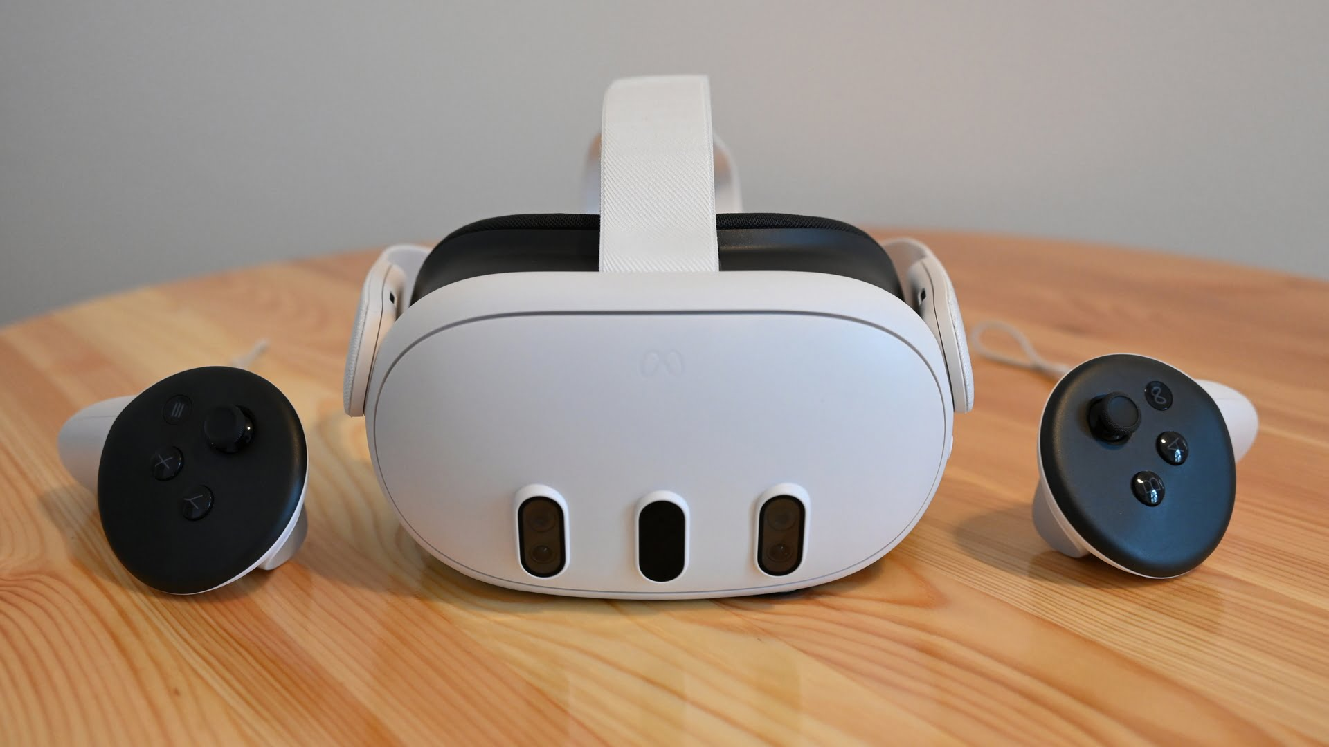
Technologies Used
XR & AI Ecosystem
• Unity-based XR platform
• Meta Quest VR devices
• Human Digital Twin models
• AI-generated adaptive workflows

Slide 10

Key Benefits
Training Impact
• Faster skill acquisition
• Reduced assembly errors
• Improved safety conditions
• Higher technician engagement

Slide 11
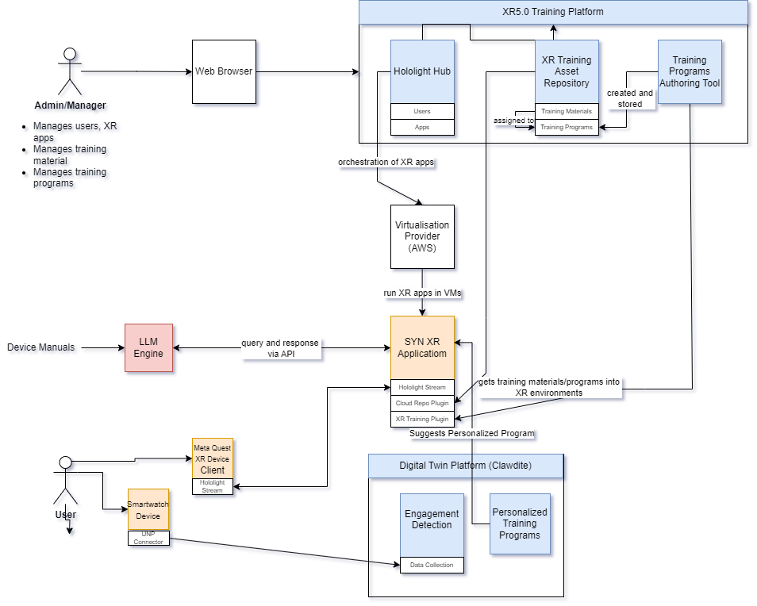
System Architecture

Slide 12
AI-Powered AR Support for Real-Time Edge Device Repairs

Slide 13
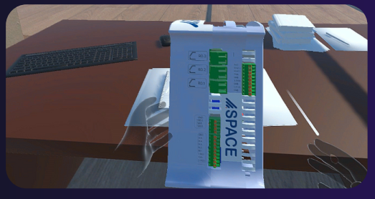

Maintenance Challenges and AR Remote Assistance
Purpose :
To showcase Extended Reality (XR) technologies specifically designed to train and assist the workers in the assembly, deployment, and maintenance of edge devices.
SPACE develops a bespoke agent for these devices, which connects to the Guardian PSIM platform for integrated surveillance rule-based incident response (e.g., triggering alarms, locking doors and safes, lighting control, etc.).
Such devices have been installed and operate in several enterprise customers in industrial domain (in the banking sector for the ATM rolling shutter to prevent theft and violation)
demonstrate the value and effectiveness of providing personalized instructional content that caters to varying skill levels of the workforce, particularly targeting beginners and intermediate-level workers.

Slide 14
Maintenance Challenges and AR Remote Assistance
Key Components:
Diagnostic and Troubleshooting Tools:
Real-time access to device diagnostics and sensor data within the XR environment assists
in the quick identification of issues.
Interactive Troubleshooting Guides: Access to comprehensive, interactive repair manuals and decision trees tailored to specific fault scenarios.
AI-Powered Fault Detection: Utilization of AI models to predict and identify common issues, providing proactive recommendations to technicians.
Real-Time AR-Based Remote Assistance
Live Support Sessions: Technicians can connect with remote experts through AR interfaces, receiving step-by-step guidance during repair tasks .
Visual Annotations: Experts can overlay visual instructions directly onto the technician’s field of view, facilitating precise and clear guidance.
Bidirectional Communication: Seamless audio and video
communication channels enable effective collaboration and
immediate problem resolution.

Slide 15
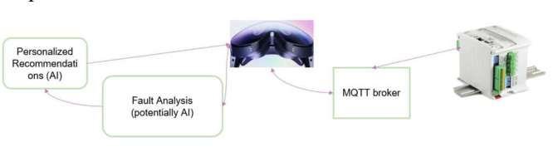
Maintenance Challenges and AR Remote Assistance
High level architecture
Field data transmitted via an MQTT broker from the edge device to the XR headset, enabling real-time interaction.
Faults or anomalies detected during operation are analyzed, which then activate tailored guidance processes.
include personalized recommendations generated through Explainable and Generative AI, visualized within the XR environment.

Slide 16


Maintenance Challenges and AR Remote Assistance
Repair & Troubleshooting Complexity
On-site
XR Guidance
• Multiple device configurations
• Fault diagnosis difficulties
• Need for expert assistance
• Downtime & operational cost
• AR-based visual instructions
• Step-by-step repair overlays
• Real-time remote expert support
• Hands-free operation

Slide 17

Operational Benefits
Field Support Impact
• Reduced repair time
• Lower operational costs
• Minimized downtime
• Increased workforce autonomy

Slide 18


Live Audience Survey & Open Discussion

Slide 19
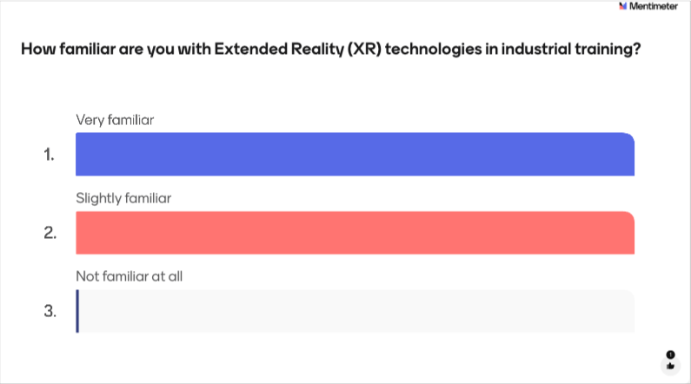

Slide 20
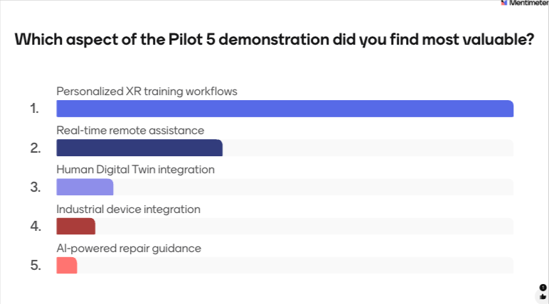

Slide 21
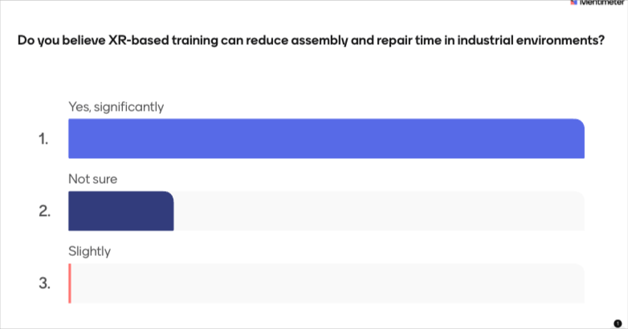

Slide 22
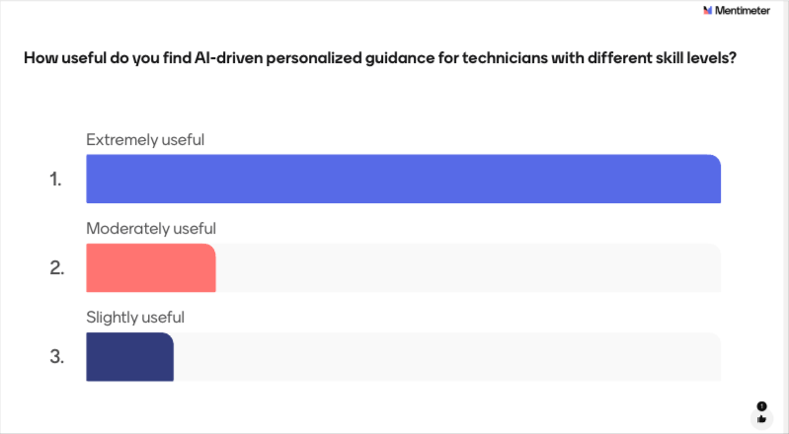

Slide 23
