Slide 1
Remote Inspection and Maintenance of Industry 5.0 Infastructures

Slide 2
Agenda
“Introduction to the Webinar” - Elina Papadopoulou, INNOV
“One Pilot, three use cases” - Karim Sergio Ladjeri, EKSO
“An augmented reality system for SmartPipe inspection” - Sophia Ppali / Fotis Liarokapis, CYENS
“LLM Chat Engine for customisable and domain-specific assistance” - George Fatouros, INNOV
“Identifying defects in pipeline networks using human - centric AI” - Stergios Chairistanidis / Dimitrios Dardanis , UPRC
“SmartPipes an API for coordinating data access” - Robert Fejer, SIE
Open Discussion – Questions & Answers
“Live audience feedback and live survey in an online event” - Elina Papadopoulou, INNOV

Slide 3
One Pilot, three use cases

Slide 4



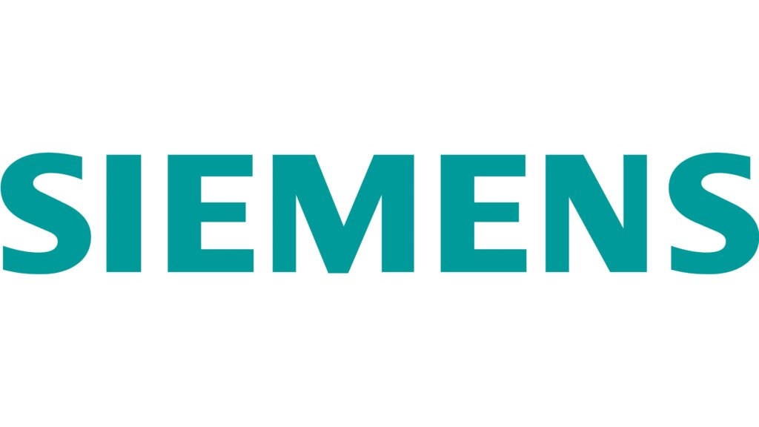


Pilot Partners
Pilot Leader
Pilot Technical Responsible
Technical Partners
GenAI
Smart Pipes AI
Speech to Text/Text to Speech
Active Learning
Neurosymbolic AI
AR App

Slide 5
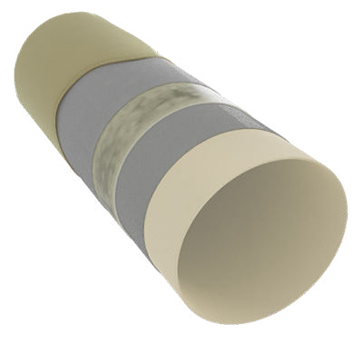
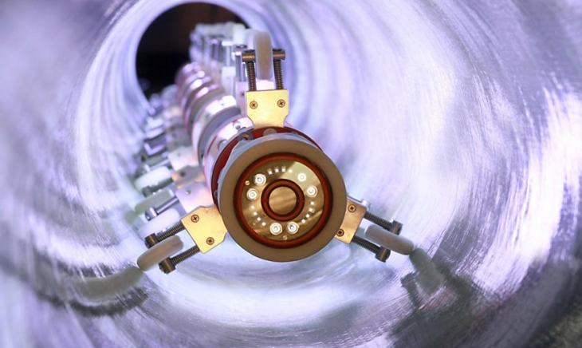
The activity behind the use cases
Pilot Leader
NO DIG/trenchless services & Tecniques
Composite materials – thermosetting resins
No excavations
Quick full pipe hydraulic & Structural restoration

Slide 6

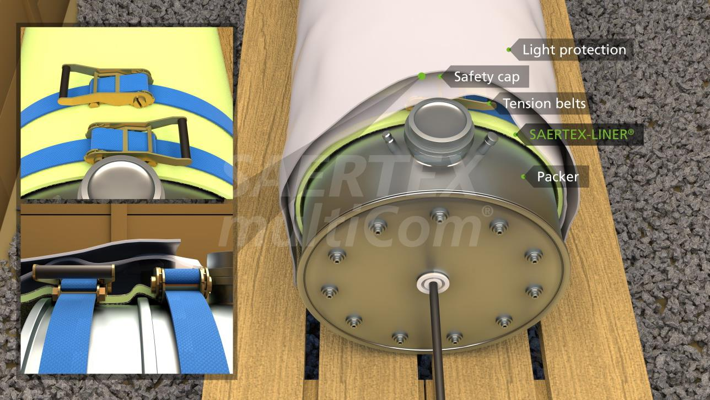
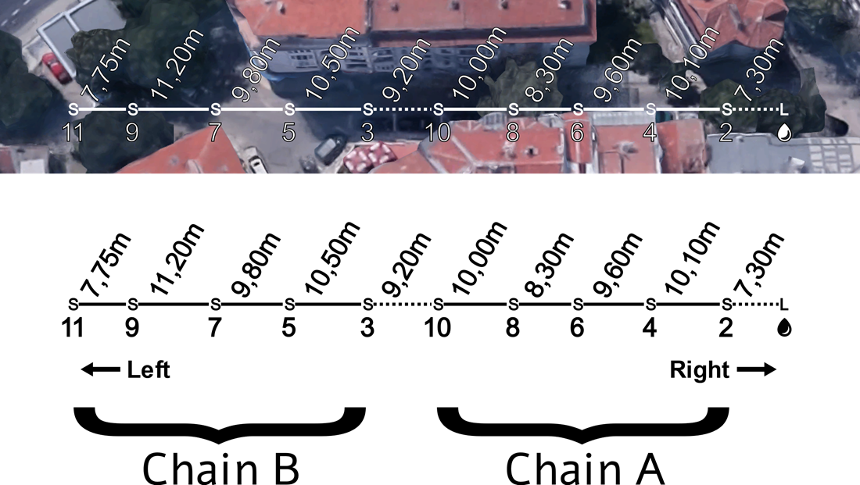
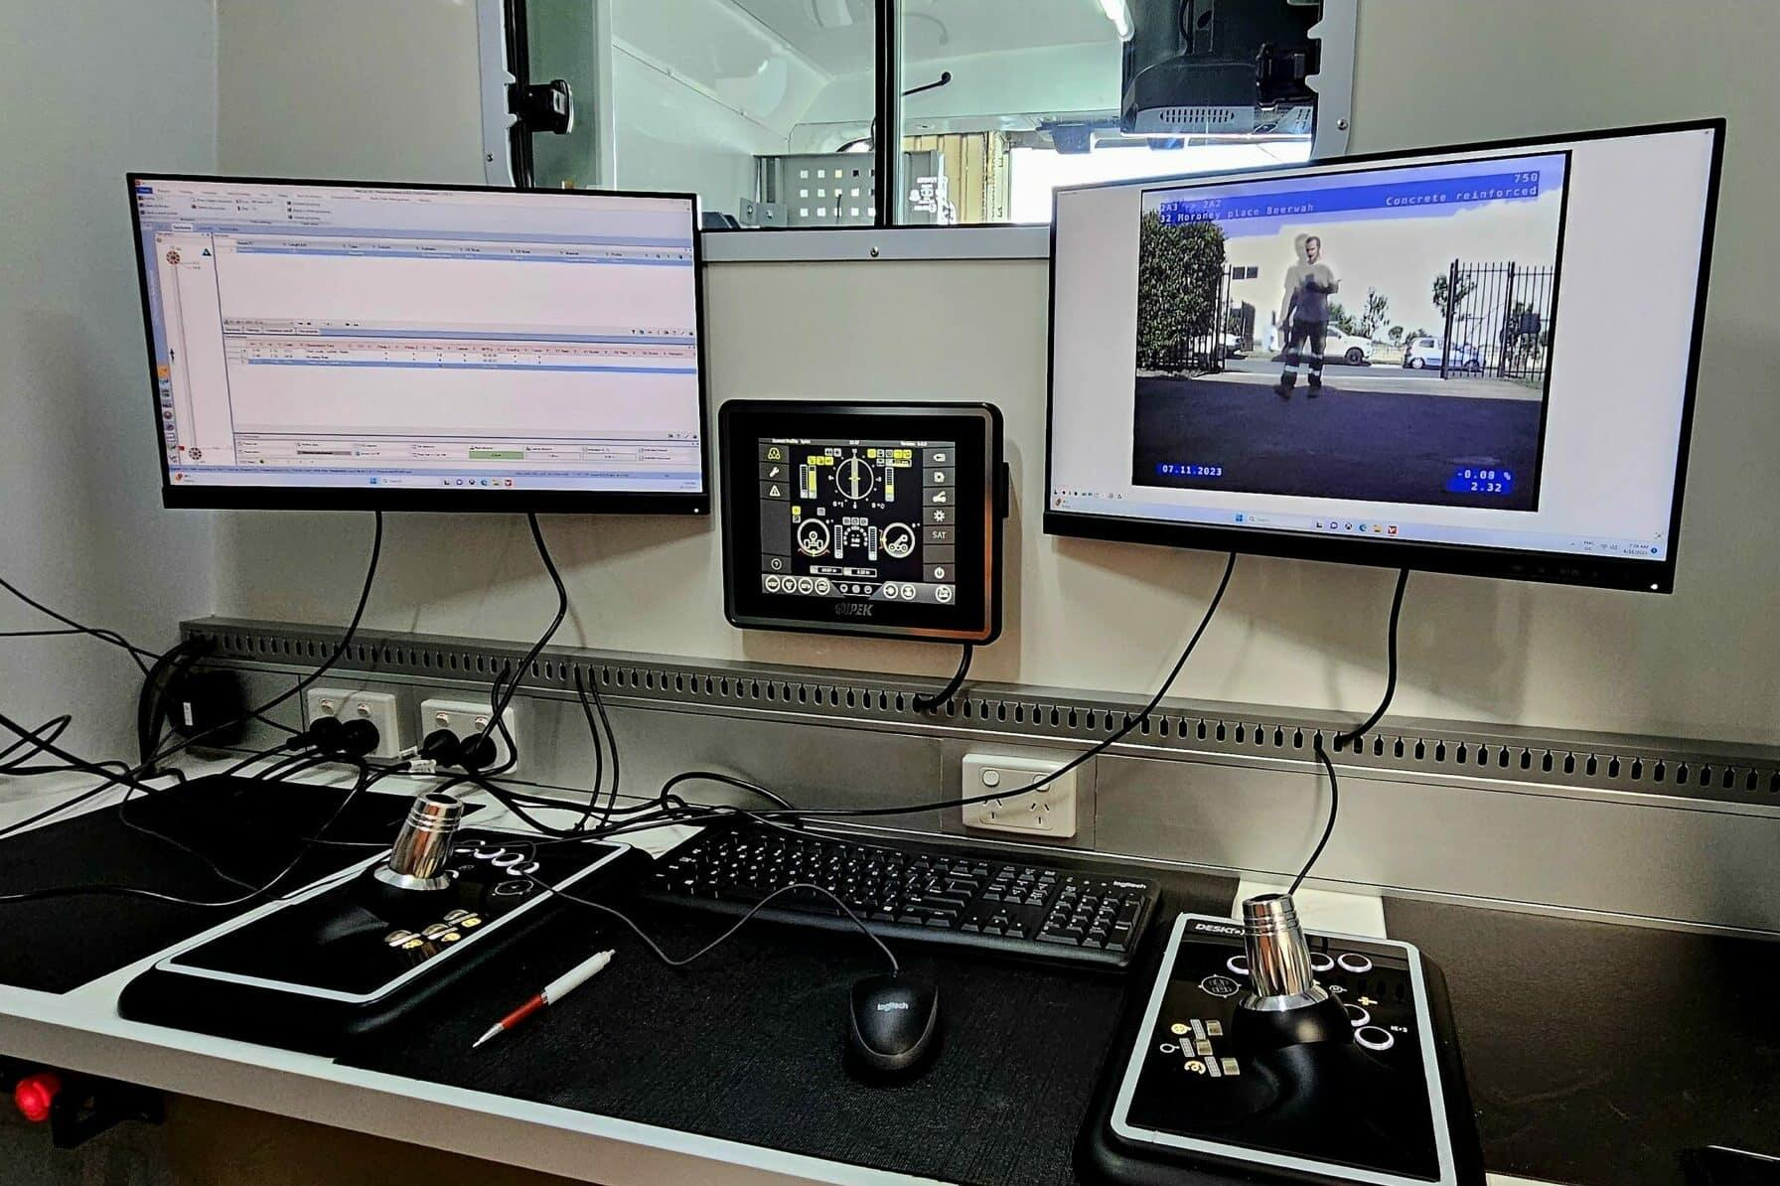
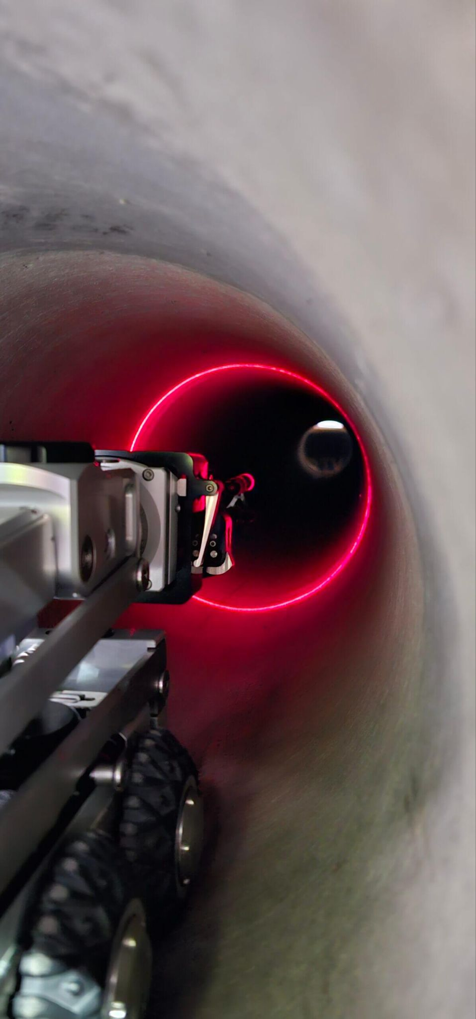
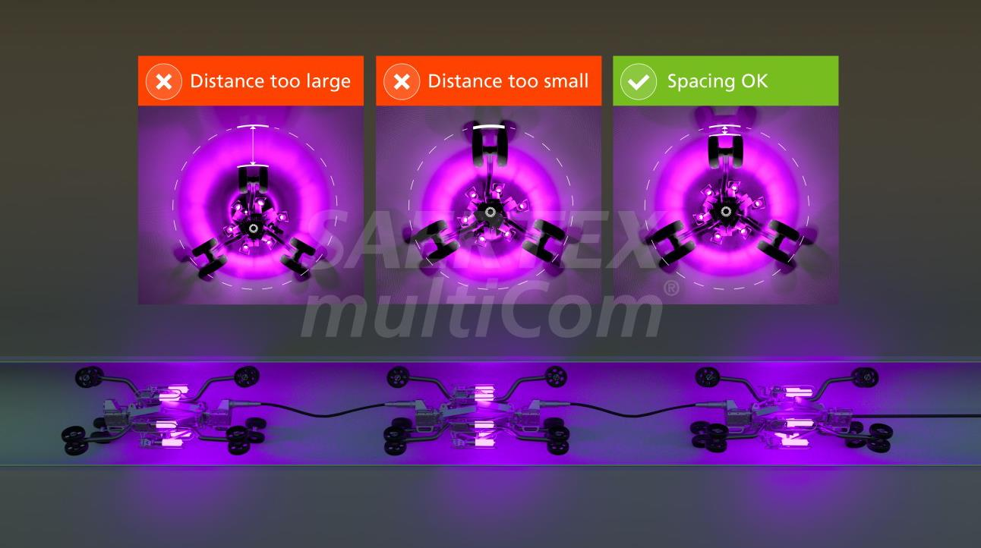
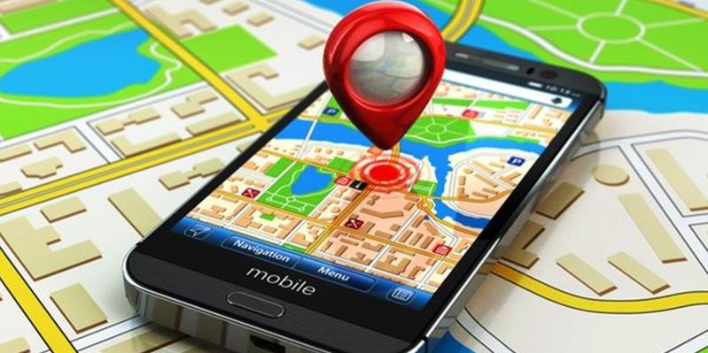
One Pilot, three use cases
Pipelines Maintenance value chain
Use case #1
Develop an effective user friendly AR interface to maximise the power of the Smart pipe sensing device (leakage detection) facilitating and speeding up maintenance interventions.
Use case #2
Develop a strong AI support for increasing efficiency of CCTV operations during pipe inspection activities.
Use case #3
Deploy an AR training and operations support for maintenance operators.

Slide 7
An augmented reality system for SmartPipe inspection

Slide 8
Problem definition
Smart pipe maintenance requires fast and accurate fault localisation
Operators need to identify where the anomaly is and where to intervene
Early XR interfaces risked showing too much technical information
Main challenge: make AI/XR output useful and simple for field operators

Slide 9
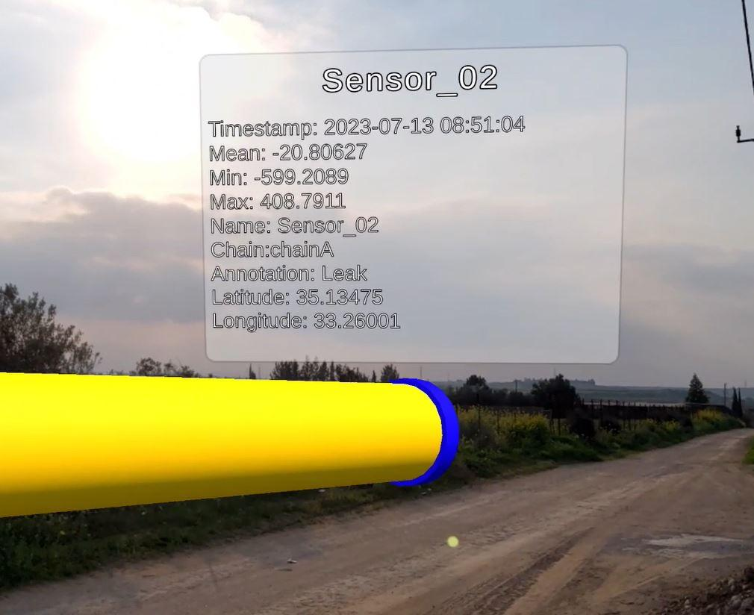
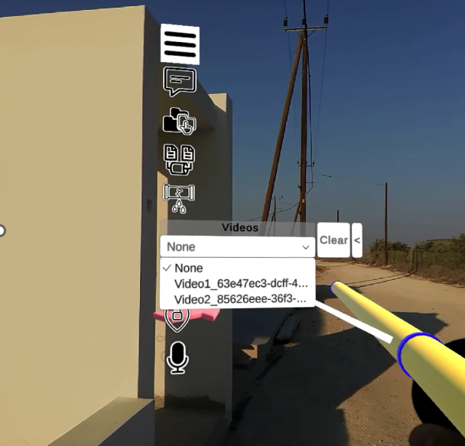
Initial Implementation
Started with Magic Leap prototype
Included pipe, sensors, anomaly display, CCTV predictions, chatbot
Feedback showed need for simpler and more practical interaction
Moved toward phone-based solution

Slide 10
Expert feedback
Prioritise simplicity for operators: interface should be minimal, intuitive, and task-focused
Hide non-essential/technical features (e.g. debug tools, configs) from standard users
Clear anomaly localisation is critical: highlight the exact area (not just a point), ideally between sensors
Use visual cues (e.g. red pipe segment, pop-ups with sensor IDs) to guide intervention
Limit core functions to 2–4 main actions with short descriptions
Avoid complex data displays: graphs and raw values should be optional or simplified
Focus on actionable insights rather than raw sensor data (operators need “where to act”)
Differentiate user levels: simple default UI, advanced views for experts/admins
Iterative refinement needed: feedback will inform second prototype

Slide 11
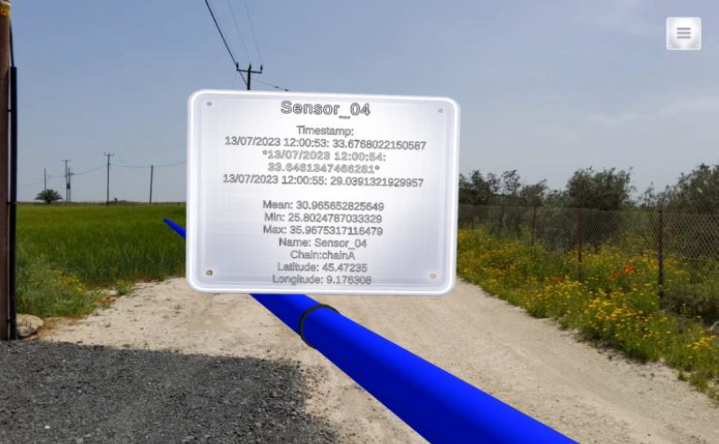
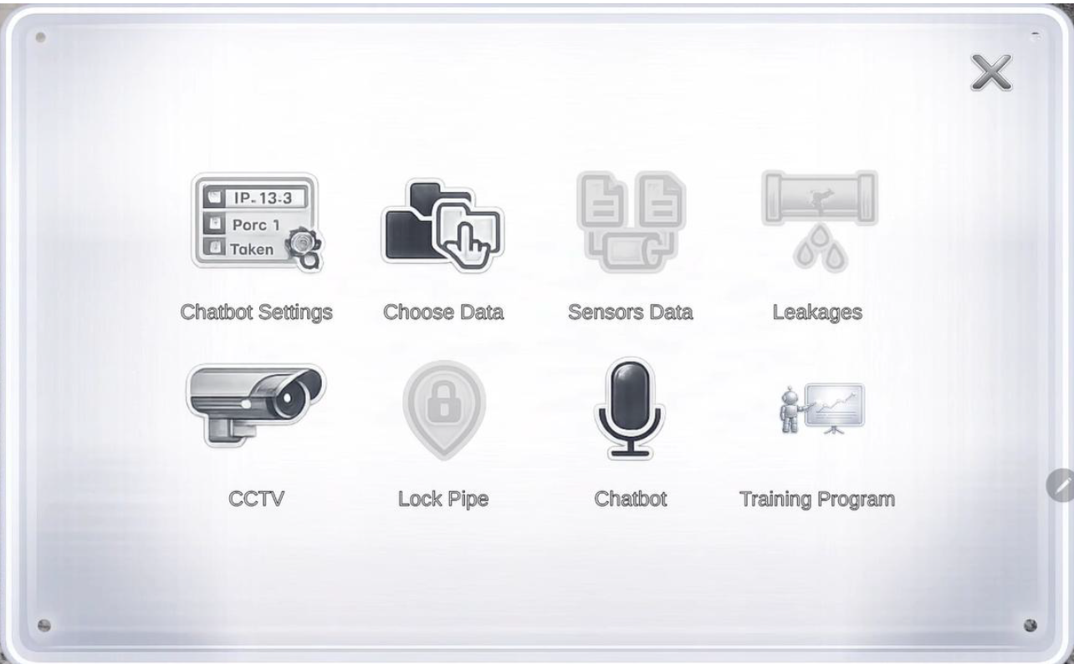
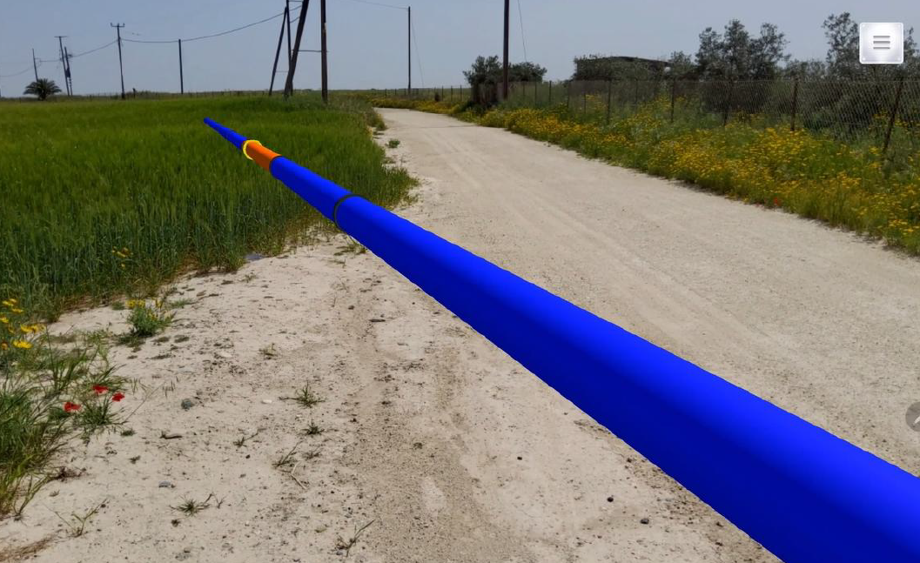
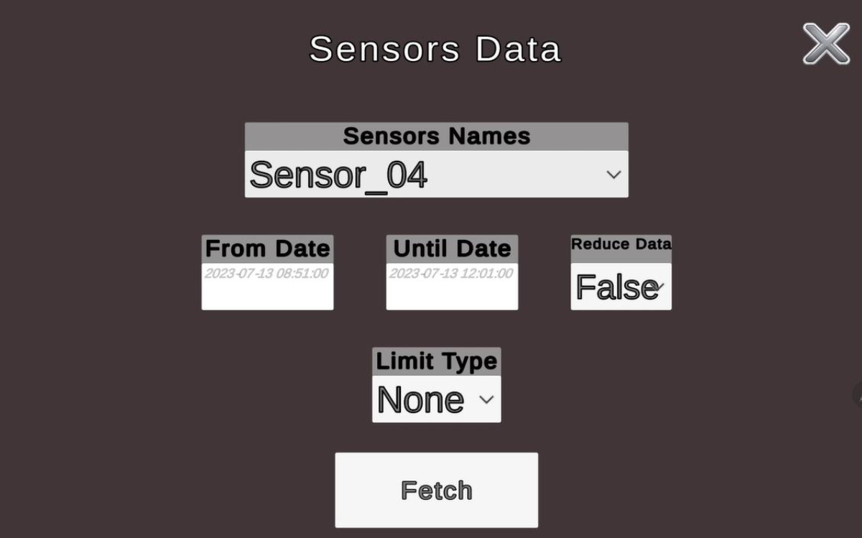
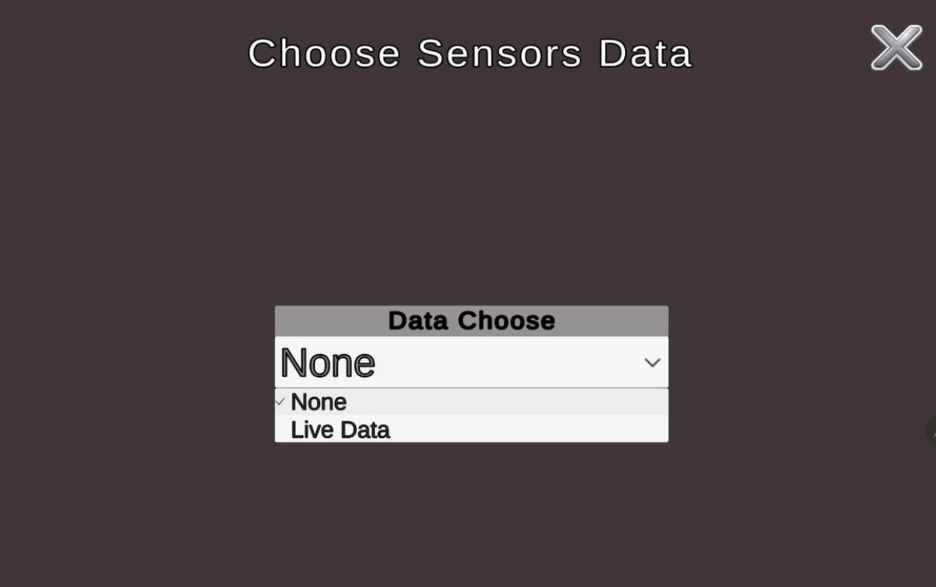
Current implementation

Slide 12
Key Takeaways
Expert feedback confirmed the value of an iterative design process
The project moved toward a more human-centred interface
Simplicity is critical for trust, usability, and adoption
Phone-based deployment improves
  accessibility
  practicality
  scalability
Future work should continue validating the interface with operators and refining advanced features separately

Slide 13
LLM Chat Engine
for customisable and domain-specific assistance

Slide 14

From Static Manuals to Intelligent Assistants
Industrial operators face a fundamental bottleneck: critical knowledge is locked in PDFs, technical manuals, and maintenance documentation that can't be queried, surfaced contextually, or adapted to a use case.
Generic LLMs hallucinate without grounding.
We solve this with a domain-specific, use case-configurable RAG-powered chat engine.

Slide 15
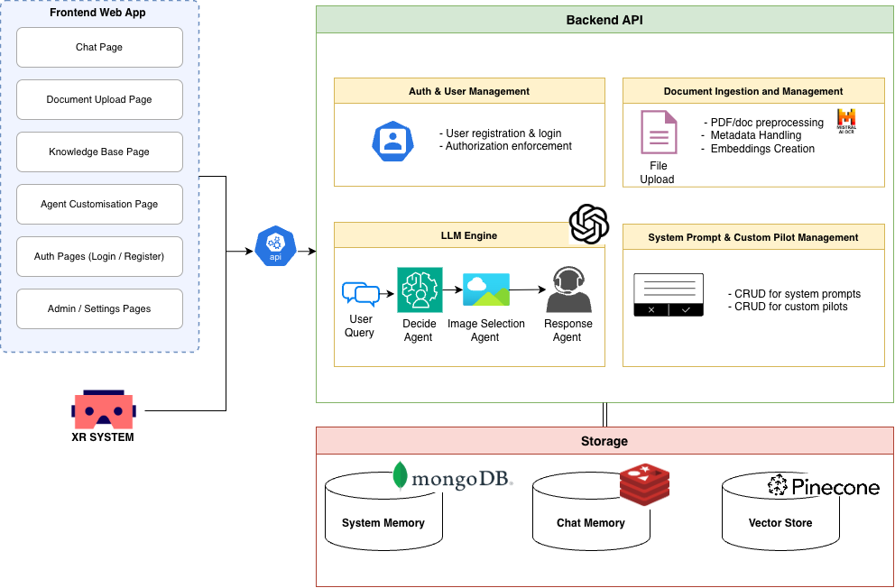
LLM Chat Engine — Architecture
Three-stage agentic RAG pipeline:
Decision Agent — interprets the query, selects retrieval strategy, issues targeted vector DB searches
Image Selection Agent — identifies which technical diagrams/figures are relevant to the answer
Answer Generation Agent — synthesises a grounded response, references images + source PDF pages
Backed by:
Multimodal document ingestion (OCR → structure-preserving chunking → image captioning via VLM → vector embeddings)
Per-pilot namespaces with customisable system prompts
MongoDB (metadata) + Redis (session memory)
Evaluation: Faithfulness 97.7%, Hallucination 2.0%
Metric
Mean Value
Faithfulness
97.7%
Hallucination
2.0%
Context utilization
75.2%
Claim recall
84.4%
Context precision
66.0%

Slide 16
One Platform for Different Industrial Use Cases
Pilot
Context
What the agent does
Pilot 3 (EKSO)
Smart water pipe inspection
Installation procedure guidance with visual aids
Pilot 5 (SPACE)
Edge device assembly training
Self-service VR/AR training support
Pilot 6 (LNS)
Industrial machine troubleshooting
Alarm diagnosis + corrective action retrieval
Pilot-agnostic architecture: A single deployment, independently configured per use case via system prompt + knowledge base. Self-service Integration

Slide 17
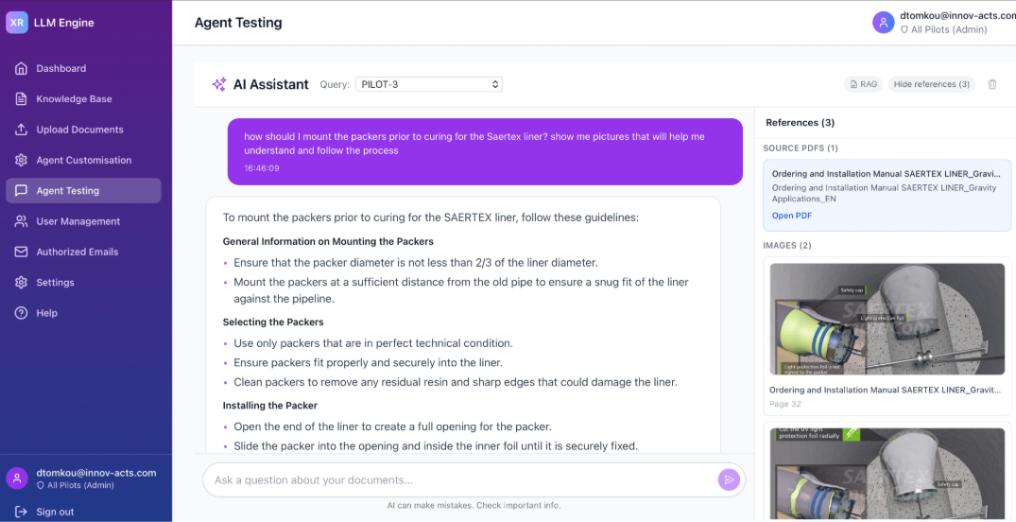
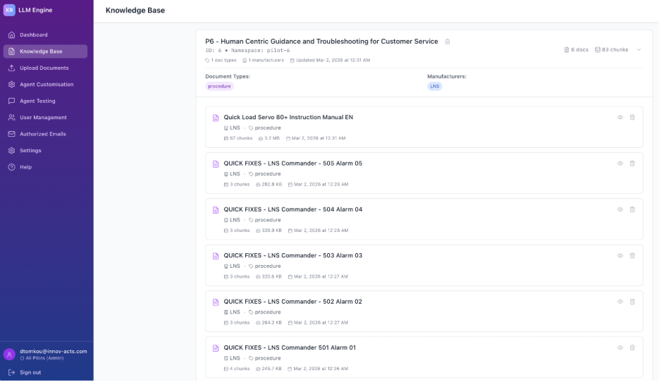
Live Demo + Key Takeaways
Demo Overview:
Upload you documents for context-aware responses
Ask a natural language question about a technical document
System retrieves relevant chunks, selects supporting images, cites source PDF with page number
Multimodal response: text + images + direct PDF access
Takeaways:
Domain-specific grounding eliminates hallucination
Pilot-agnostic scalability across industrial verticals
Agent Customization & Adaptation
TRL 7–8 validated through real pilot deployments

Slide 18
Identifying defects in pipeline networks using human - centric AI

Slide 19
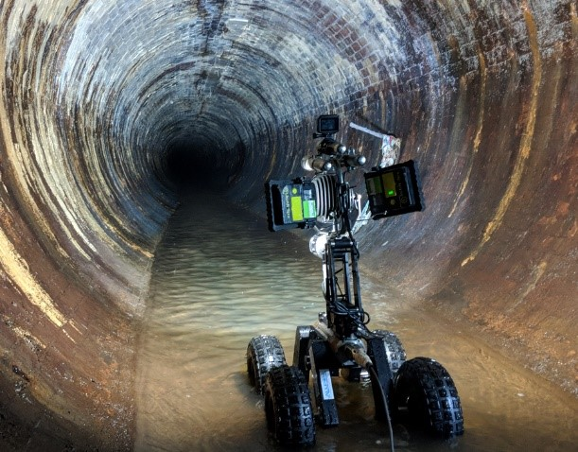
Problem Description and proposed solution
CCTV inspection of water pipelines is a highly demanding process that relies heavily on human operators, requiring sustained focus, time, and manual effort to identify potential issues.
We wanted to leverage AI technology in order to tackle this problem in an XR environment.
For each prediction, the model also identifies and highlights key concepts present in the frame that contribute to its decision-making process.
By associating predictions with interpretable concepts, the system provides transparency into how and why a specific anomaly was flagged.
A model has been developed to effectively detect and capture outliers in CCTV pipeline inspection data.
Its performance is further enhanced through the integration of an Active Learning module, which incorporates feedback from domain experts.
This feedback loop allows the model to continuously improve by learning from expert corrections and validations.

Slide 20
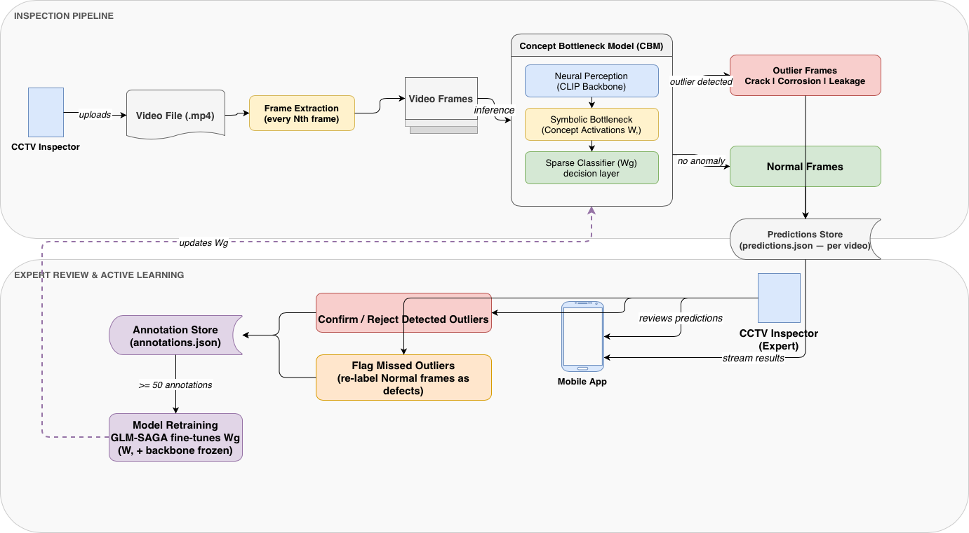
System Architecture

Slide 21
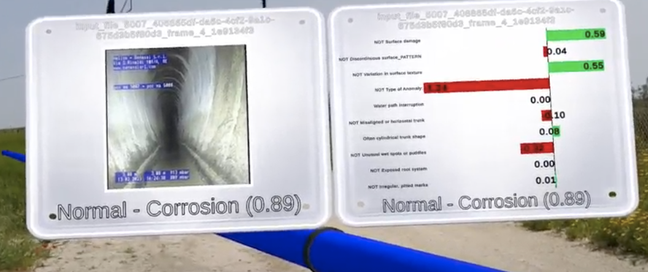
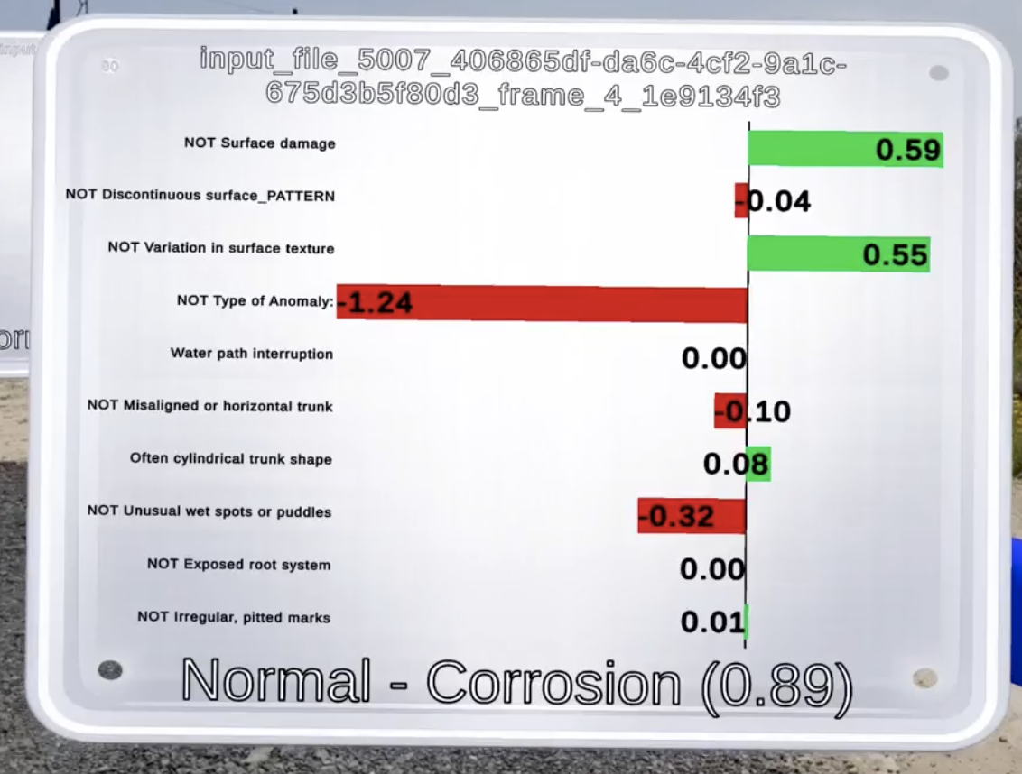
System in Action
Model’s Prediction inside the XR app
User select the pipe under inspection and can see the specific frames and whether that frame is an outlier or not
Along with model’s predictions there is the model confidence as well as the features identified in the image
Model bases its prediction based on those specific features rather than just outputting a likelihood for each class

Slide 22
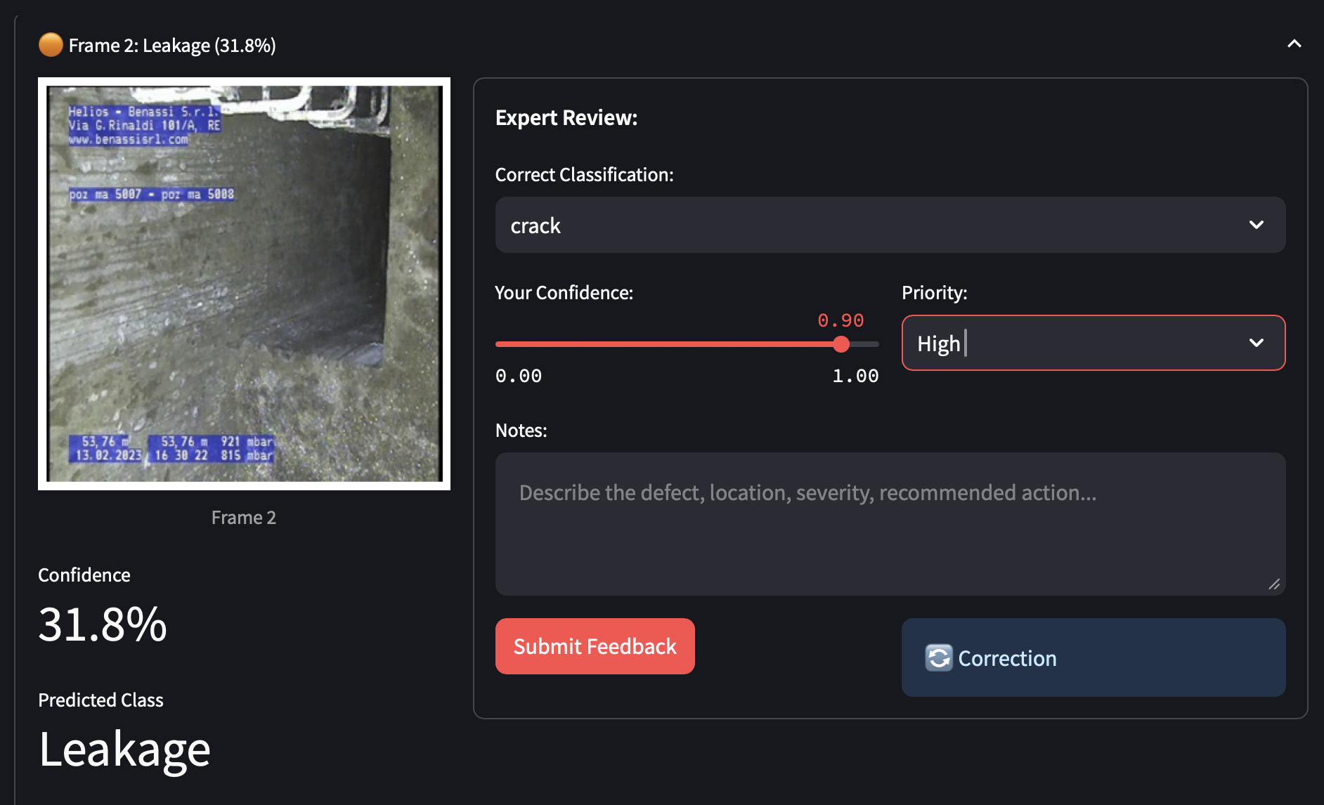
Expert’s Feedback
Model can be improved via human in the loop interaction
Based on the Active Learning component, predictions that model is not fully confident are flagged and expert can intervene
The fact that training data of outliers is limited, expert’s feedback allows for better predictions without the need of huge datasets
Model retrains after a specific amount of feedback

Slide 23
Key Takeaways
A Concept Bottleneck Model (CBM) is employed for outlier detection, offering an explainable approach that complements the CCTV inspection process
An Active Learning framework is incorporated to maintain a human-in-the-loop setup, allowing expert feedback to guide the model’s improvement..
The model enhances human cognition by assisting inspectors in efficiently identifying potential issues while providing clear, concept-based explanations for its predictions, enabling deeper understanding of its reasoning and enabling greater trust and confidence in its outputs.

Slide 24
SmartPipes an API for coordinating data access

Slide 25
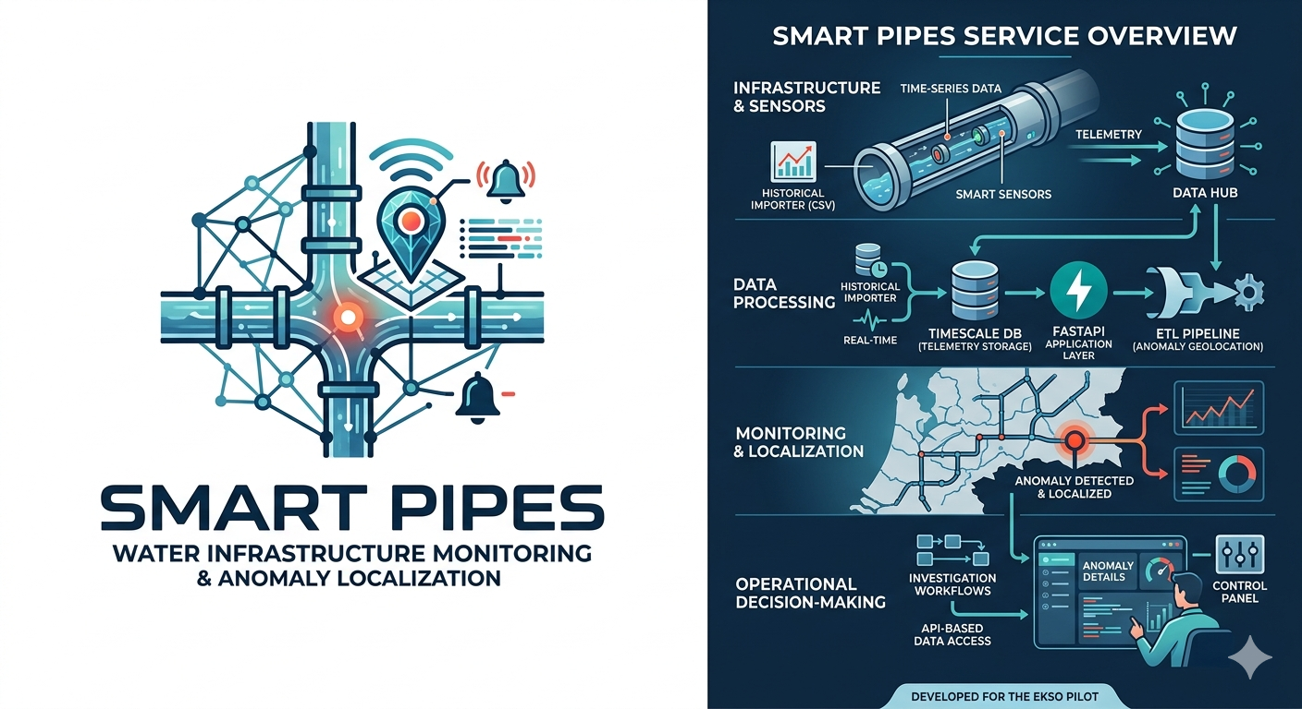
Summary
The Smart Pipes system is a water infrastructure monitoring and anomaly detection solution developed for the EKSO Pilot. The current solution combines time-series data ingestion, geospatial anomaly localization, and API-based data access to support monitoring, investigation, and operational decision-making across instrumented pipe networks.
Technical Specification
The platform integrates TimescaleDB for high-volume telemetry storage, a FastAPI-based application layer for data access and anomaly workflows, a CSV-based historical importer, and ETL pipeline for anomaly geolocation processing. Together, these components provide a practical foundation for infrastructure monitoring, analytics, and demonstration workflows.

Slide 26
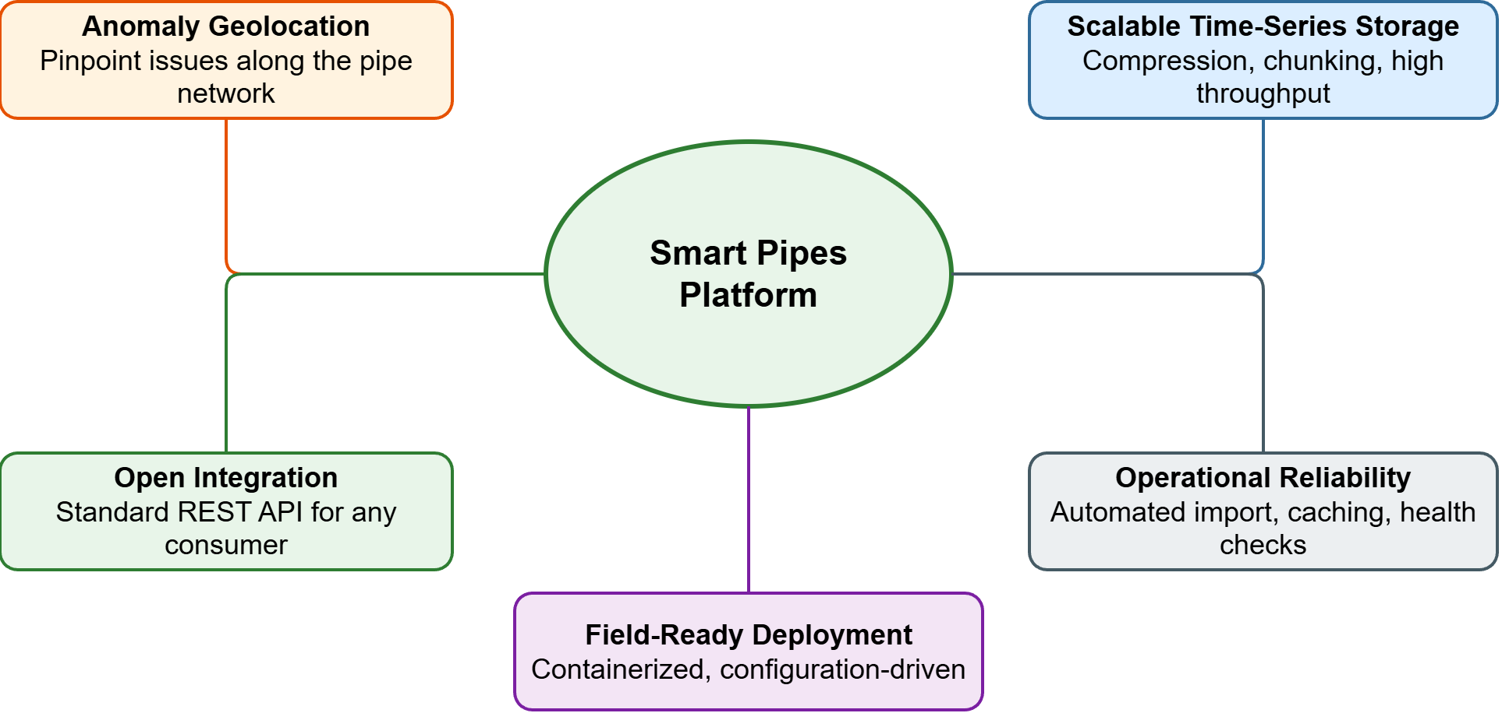
Key Capabilities and Value
Anomaly geolocation — pinpoints issues along the pipe network from sensor-derived distance data
Scalable time-series storage — handles large volumes of telemetry with TimescaleDB compression and chunking
Open integration — standard REST API allows any application to consume sensor and anomaly data
Operational reliability — automated data import, query caching, and health monitoring built in
Ready for field deployment — containerized services, configuration-driven, deployable with Docker Compose

Slide 27
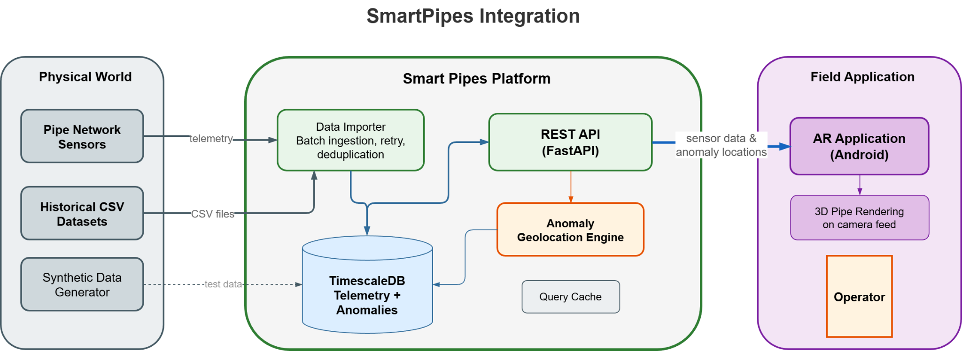
High Level Architecture

Slide 28
Live Audience Survey & Open Discussion

Slide 29
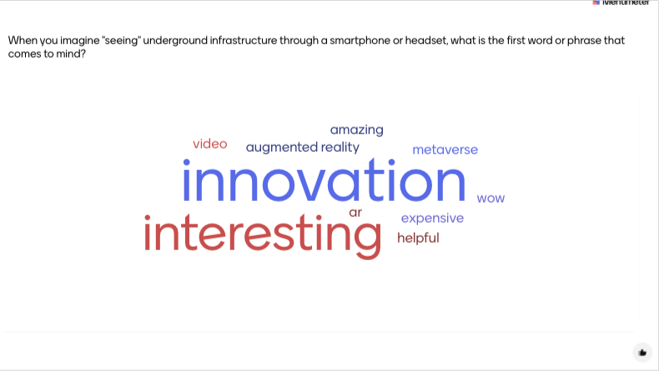

Slide 30
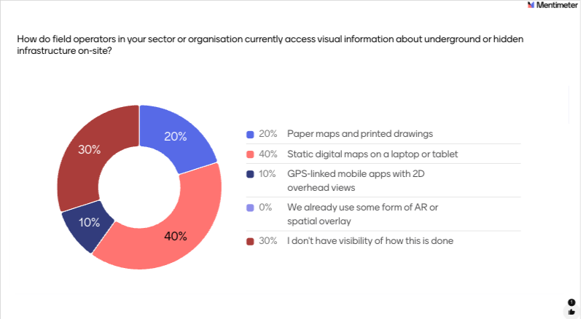

Slide 31
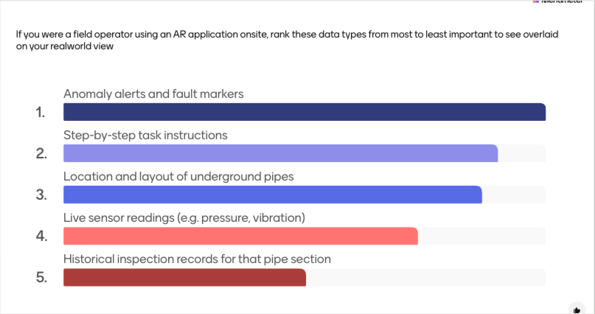

Slide 32
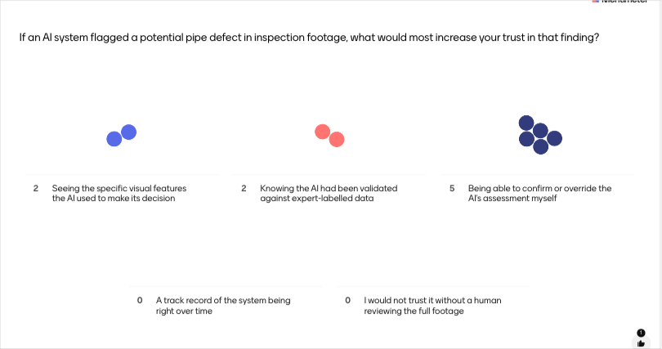

Slide 33
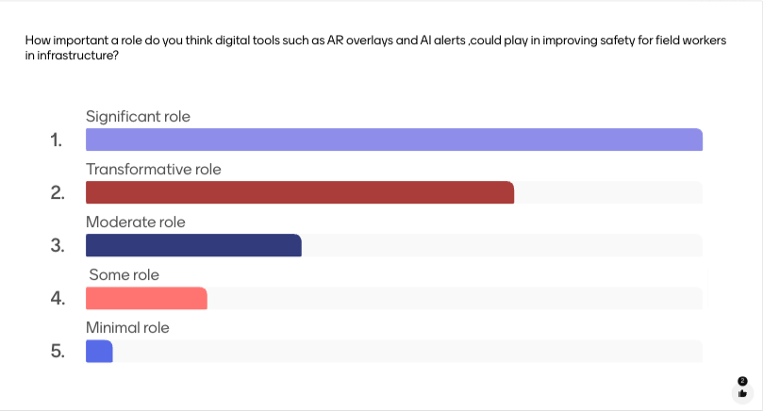

Slide 34
